Slide 1
The Water Cycle
Turning mother tongue lesson material into CLIL

Slide 2
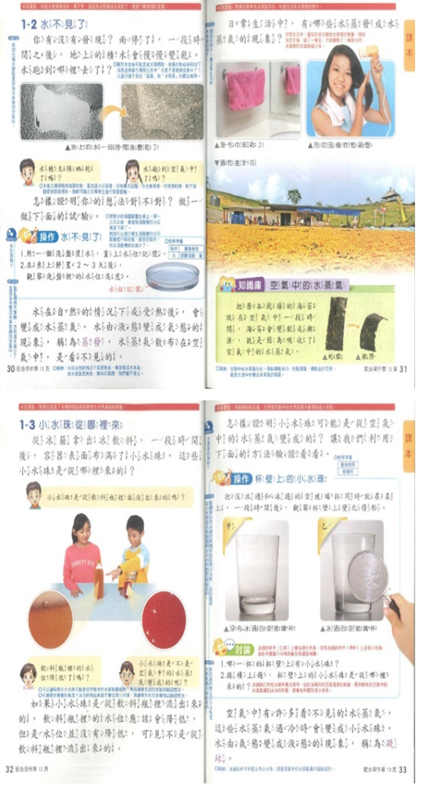
Chinese Gr 3 Science from Taiwan

Slide 3
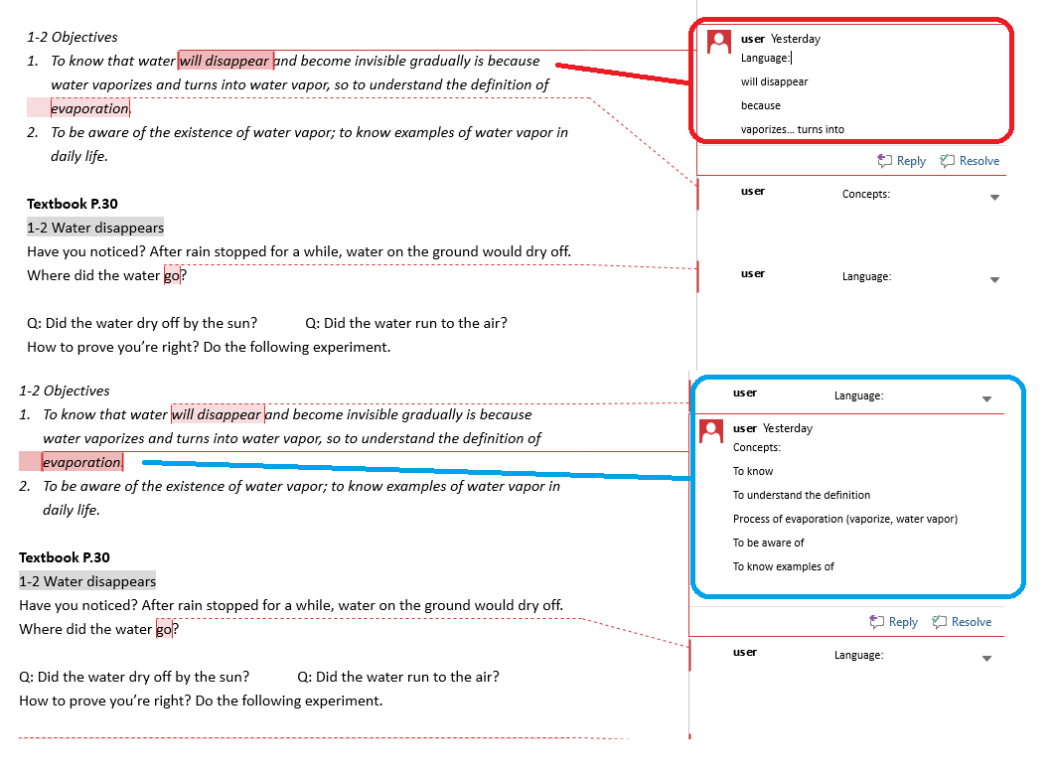
Analysing the material in 3D

Slide 4
Concepts
We have defining evaporation and condensation.
We have describing these two processes.
We have some description of aspects of the processes and the different conditions they occur.
We have identifying examples from every day life.

Slide 5
Language
We have some subject specific terminology (evaporate, vapor, vaporize, condense, condensation, absorb).
We have general academic language for:
defining - The process where … (water / vapor) changes to (vapor / water) … is called … (evaporation / condensation)
describing different conditions - (under natural / heated conditions… In what other circumstances will / does…)
describing processes and cause-effect - When …, … / If …, … / will + infinitive, simple present – becomes / will become – absorbs / will absorb – evaporates / will evaporate – condenses / will condense – is covered with / will be covered with).
There is also less explicit peripheral language accompanying the practical observation activities which will probably have the teacher explaining what to do, and interacting with the learners during the practical.
Also, as we have a cycle and processes, it is a good idea to accommodate sequencing phrases, though they are not a focus in the textbook pages – First, Next, After that, Eventually, Then, Finally, etc.

Slide 6
Procedures
We have - observe (the level of the water / the droplets on the container)
The only other procedures I can identify, apart from the multiple questions on the page of course, are the two instructions to carry out observations. Firstly, learners are asked to observe water evaporation in a plate over several days. Secondly, learners are asked to observe condensation on an iced drinks container (and compare that with an un-iced container.

Slide 7
Suggestions input / output
We need more procedures!
(Learners need to speak and write)
So, what input will you use (text, visual, video, objects, pictures, animations, etc) and what output will you expect (spoken output or written output) from your learners?

Slide 8
Input
Use images of the processes happening (evaporation, condensation), show them on screen, talk through them to your learners. As they listen and watch, give them cards with descriptions of the steps in the process that they have to put in the correct order while they watch you.
Use video showing these processes and give learners a very simple task to do while watching. Again, these might be the steps they see in the process which they simply put in the correct order.
Use text description of the process and get learners to put them in the right order.
Use text description of the process, give half of the sentences to learner A and the other half to learner B and tell them to talk to each other asking and answering questions about their missing text in order to fill in the missing information.
Create a diagram of the process (process of evaporation, process of condensation, the water cycle) and produce a blank version to hand out the learners. You can use this diagram for learners to use during their initial viewing of a video, or listening to your talk, or reading the input text. NB – put learners in groups of 3 and give them the blank diagram, give them headings cards for the names of the steps, and give them descriptor cards for explanation of what is happening at each step and then tell the 3 to talk to each other to reconstruct the diagram, labels and descriptions.
Depending on the amount of subject-specific terminology in a lesson, you might also use vocabulary learning games (like taboo) and applications (like Quizlet).

Slide 9
Output
With output, you have to decide what is expected of your learners. Look back to the objectives. Do you want your learners to be able to write definitions, to speak definitions, to write a process description for evaporation and condensation? Once you identify what is expected, create tasks to take learners to that point.
Create a variety of interactive communication tasks using the content language from the theme (paired speaking, group speaking, information searching in the whole class, word guessing games).
Create instruments to scaffold (substitution tables, gapped sentences, writing frames) language for describing the processes in order that your learners will be able to produce accurate academic language when facing the task ‘Write a description of the process of evaporation when a wet towel is hung on a hot radiator’ or ‘Write a description of the process of condensation when an iced glass is placed in a warm room’.

Slide 10
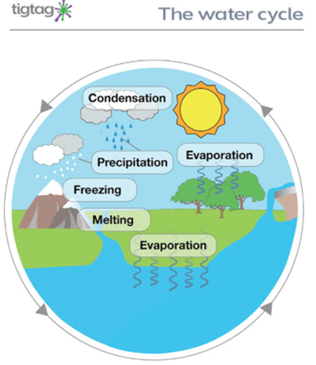
Materials suggestions
Warm up - Refer to any of the every day life examples
Input Visual - Use a video showing the ‘big picture’ process of the water cycle
I use the videos in https://www.tigtagworld.com/clil/
Watch and label
Input Text - Build on the input visual

Slide 11
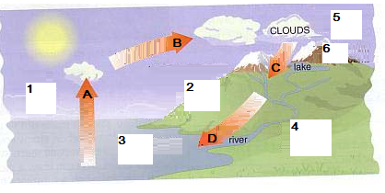
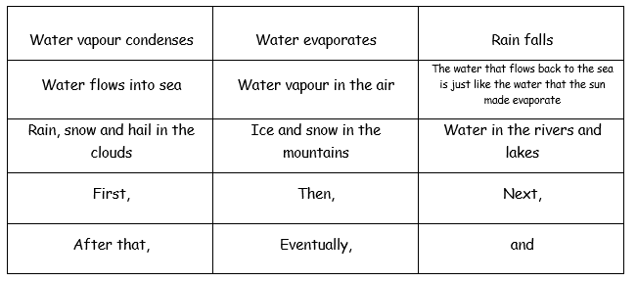
Materials suggestions
give learners work in groups - text plus visual

Slide 12
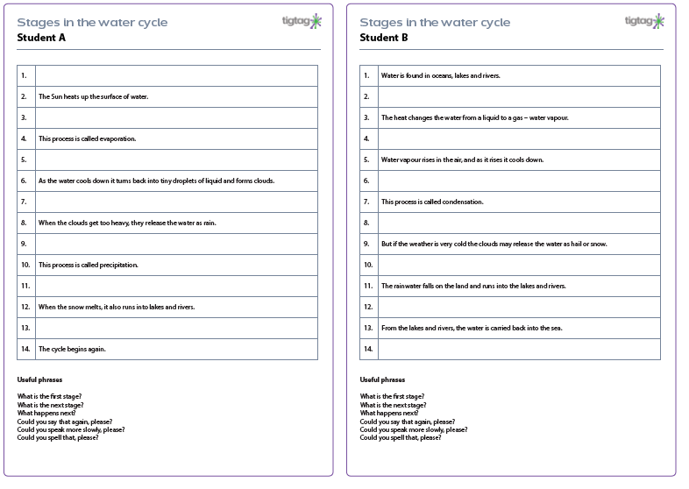
Materials suggestions
Create information sharing speaking

Slide 13
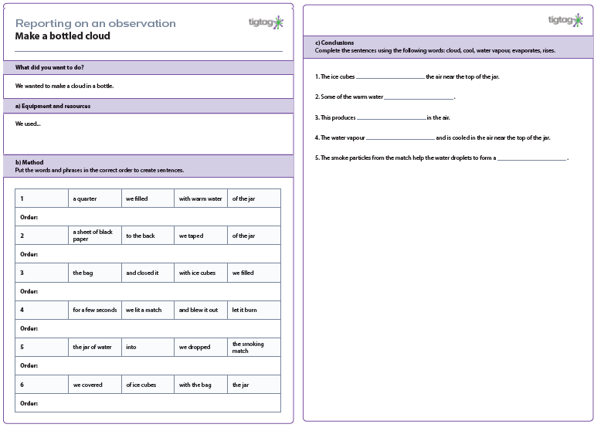
Materials suggestions
Build up to writing output

Slide 14
Final thoughts…
Take a 3D look at your materials
Concepts, Procedures and Language
Build from input to output tasks
Can I help you?
Send me your lessons.
keith@anglia-school.info

