Slide 1
Nyon - needs analysis
Keith Kelly
keithpkelly@yahoo.co.uk
IFFP

Slide 2
History
Work in subject-specific teams
(WWII, Decolonization, Fascism)

Slide 3
History
Page 16
How far were the German people dissatisfied with the terms of the Treaty of Versailles? (10 marks)
Sample answer: The treaty presented to the German Delegation was imposed on them. They had not been allowed to take part in the Conference and considered the Treaty a ‘Diktat’. Some German delegates even considered refusing to sign it.
There were many aspects of the treaty that were hated. The Loss of territory including Alsace-Lorraine, for example angered many ordinary Germans. Other countries were allowed self-determination but the Treaty of Versailles forced some Germans to live under foreign rule (e.g. Polish rule in the East). Germany was also not allowed to unite (Anschluss) with Austria. Military restrictions were also placed on Germany and many Germans felt vulnerable to future attack as well as loss of pride. Members of the German armed forces felt particularly angry about this aspect of the Treaty.

Slide 4
History
The new Weimar Government had to pay the Allies huge reparations. Many Germans, including business leaders and politicians thought this was unfair and designed to bankrupt the German economy and keep it weak. Germany was also not allowed to join the League of Nations (finally joined in 1926) and many Germans considered this a further insult to their pride.
Germany was forced to accept responsibility for starting the War. Most Germans did not accept this and many in the German Army did not think they had been beaten but betrayed by politicians in Berlin who seemed to accept defeat and signed the Treaty of Versailles. This was possibly the most hated part of the treaty.
Finally, most of the German people hated the treaty of Versailles and many blamed their own politicians for signing. Most of the German Army thought that France had had its revenge and some even wanted to restart the war. Germany had been forced to take responsibility for starting the war, been humiliated by the victorious powers, made to pay reparations, lost one tenth of its territory, most of its military strength and could not unite with Austria.

Slide 5
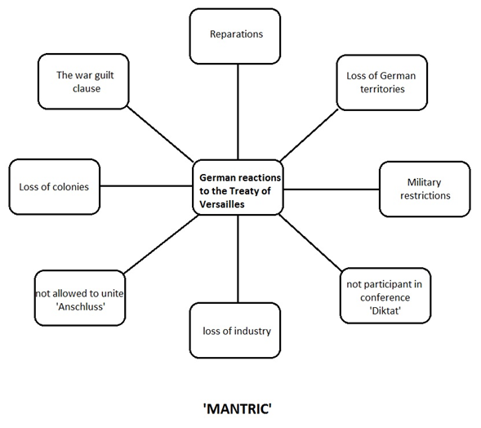
History - Language help

Slide 6
How far were the German people dissatisfied …?
‘angered many ordinary Germans’
‘felt vulnerable to future attack’
‘felt a loss of pride’
‘felt particularly angry about this’
‘thought this was unfair’
‘considered this a further insult to their pride’
‘did not accept this’
‘did not think they had been defeated’
‘felt betrayed’
‘was possibly the most hated part of the treaty’
‘hated the treaty’
‘blamed their own politicians for signing’
‘forced to take responsibility’
‘had been humiliated’
‘made to pay reparations’

Slide 7
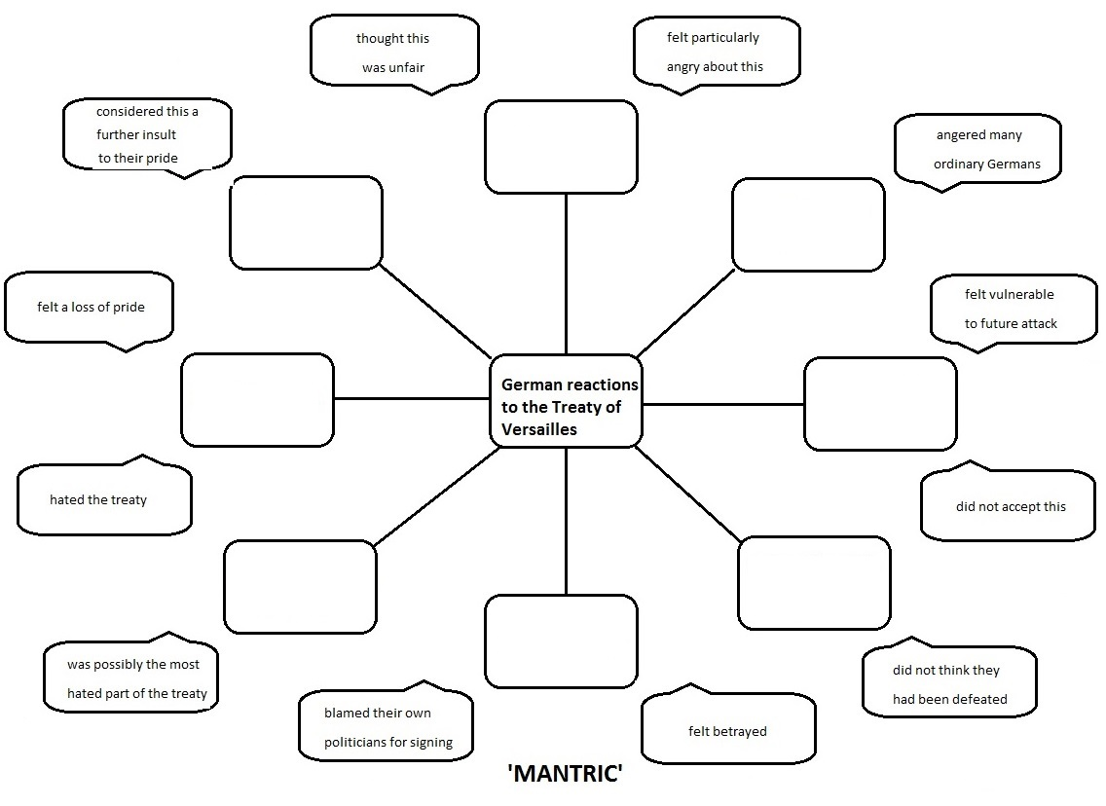
History - Language help

Slide 8
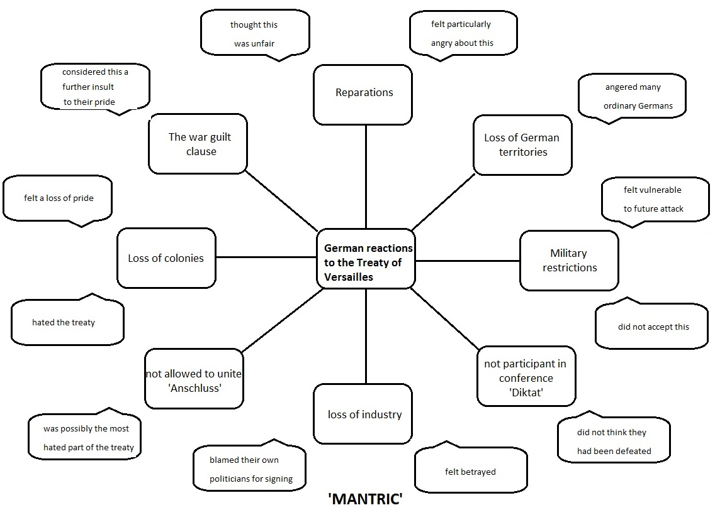
History - Language help

Slide 9
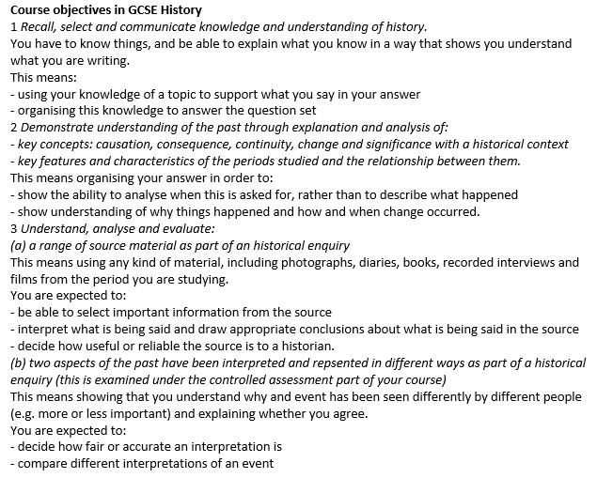
Thinking and language in History

Slide 10
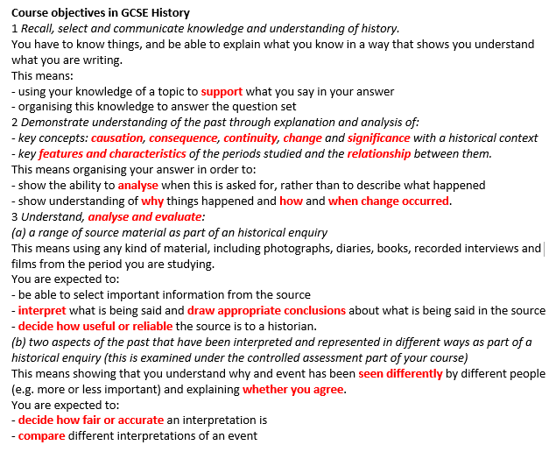
Areas of language in History

Slide 11
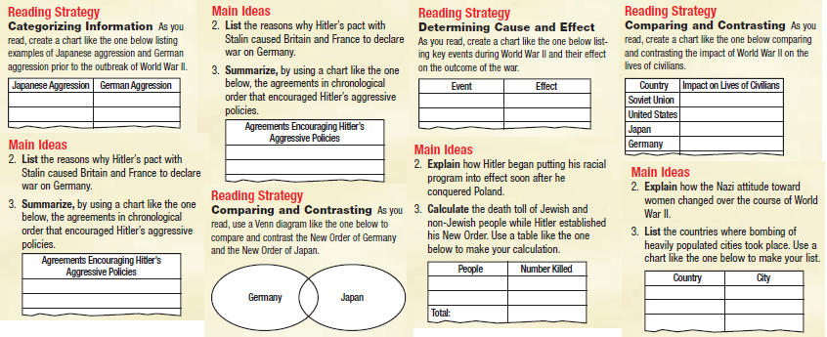
Organizing ideas in History

Slide 12
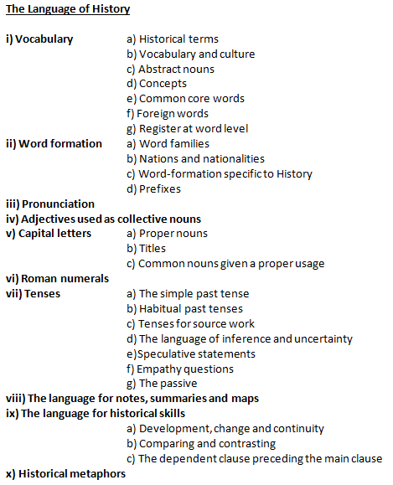
Areas of language in History

Slide 13
History - support
- Language
– identify ‘invisible’ general academic language
– make language visible and accessible
- Structure
– identify ‘conceptual’ structures in content
– exploit conceptual structures in tasks
– dealing with written output (types, lengths, structures)

