Slide 1
Soft Skills – a bridge between language CLIL and content CLIL
Keith Kelly
keith@anglia-school.info

Slide 2
Context
Meaning for young people in an international context
  The EU context
    The workplace (competing in employability)
    Skills (Life Skills and EU Competences)
    Languages (speaking several languages)
  Classroom practices
    Culture (becoming global citizens)
    Models for communication through education
    International networking (schools links)

Slide 3
European context
Young people, mobility and employability
  What makes young people mobile?
    Languages (and intercultural communication)
  What makes young people employable?
    Soft skills as much as technical skills

Slide 4
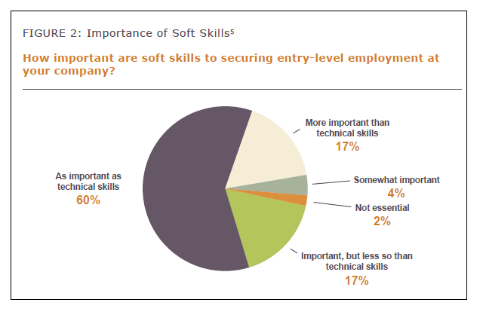
What employers say
The Importance of Soft Skills in Entry-Level Employment and Postsecondary Success: Perspectives from Employers and Community Colleges, Seattle Jobs Initiative 2013

Slide 5
What are life skills?
personal management and social skills which are necessary for adequate functioning on an independent basis
International Bureau of Education
Life skills education is designed to facilitate the practice and reinforcement of psychosocial skills in a culturally and developmentally appropriate way; it contributes to the promotion of personal and social development
World Health Organisation
It is evident that in addition to practical and vocational skills, other types of skills such as social, individual and reflective skills are also needed. Life skills programmes emphasise abilities that help to facilitate communication, negotiation, to think critically and solve problems and make independent decisions.
UNESCO Institute for Education

Slide 6
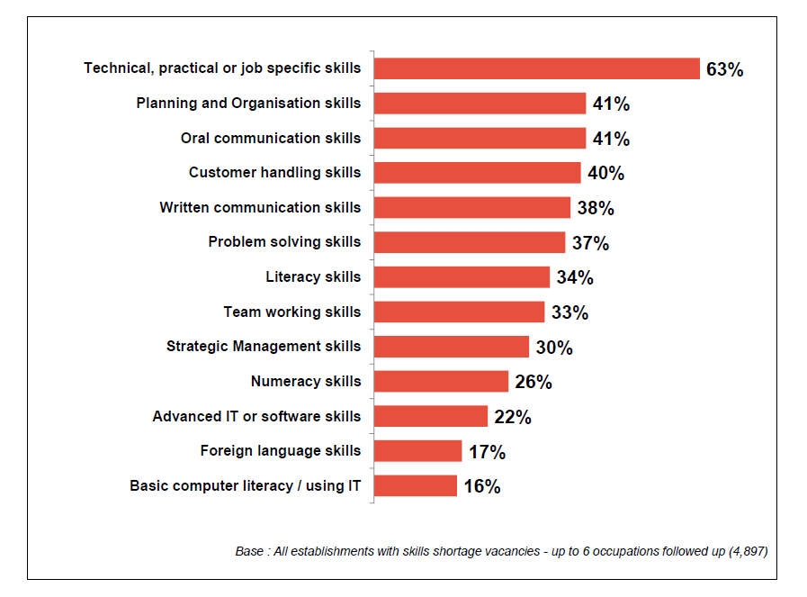
Skills lacking
UK Commission for Employment and Skills Report, 2014

Slide 7
Top ten skills that employers want
1 Verbal communication
2 Teamwork
3 Commercial awareness
4 Analysing and investigating
5 Initiative / Self-motivation
6 Drive
7 Written communication
8 Planning & organising
9 Flexibility
10 Time management
Other skills seen as important
global skills
negotiating & persuading
leadership
numeracy
computing skills
self-awareness
confidence
lifelong learning
stress tolerance
integrity
independence
developing professionalism
action planning
decision-making
interpersonal sensitivity
creativity
University of Kent study of multiple surveys

Slide 8
A model for intercultural communicative education
Culture A and Culture B
AA | BA
AB | BB
Know how your own culture sees itself
Know how other culture sees your culture
Know how your culture sees other culture
Know how other culture sees itself

Slide 9
Making language meaningful in context
identifying structures of content and concepts in order to embed patterns of language
identifying key skills and the accompanying language
- Ethnographic skills in the language classroom (making observations, researching, data collection, data presentation, drawing conclusions, comparing data sets)
- Science Across the World (issues in society: keeping healthy, healthy eating, protecting the environment, waste, climate change, air pollution, road safety)
- TrashedWorld (paper, metal, glass, plastic, organic waste, consumption, incineration, landfill, recycling, reusing, refusing)

Slide 10
From concepts to language
Heredity – possessive structures
Road Safety – describing numbers
Climate Change – conditionals and modals
Daily diet – habits and adverbs
Food consumption data – comparative/superlative adjectives
Interviewing – direct / indirect questions
Lobbying – formal letter writing

Slide 11


Slide 12

Topics (1)
Acid rain
Biodiversity around us
Chemistry in our lives
Climate change
Domestic waste
Drinking water
Eating and drinking
Global warming
Keeping healthy
Plants and me
Renewable energy
Talking about Genetics
What do you eat?

Slide 13

Structure
Teachers’ notes (language and science)
Exchange form: heart of the topic
Students’ pages
  activities
  discussion
Ideas for extra activities

Slide 14
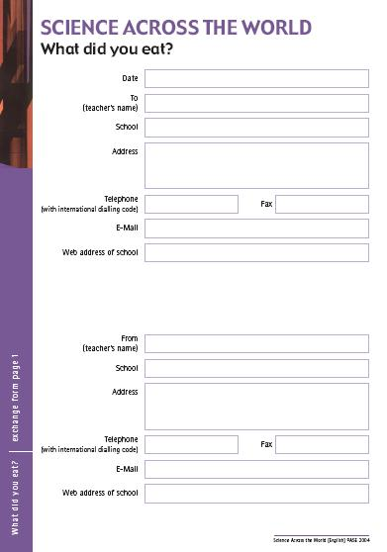
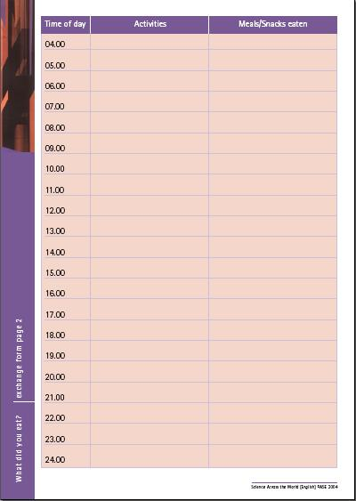
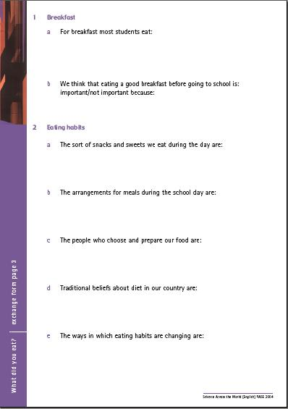

The Exchange Form

Slide 15
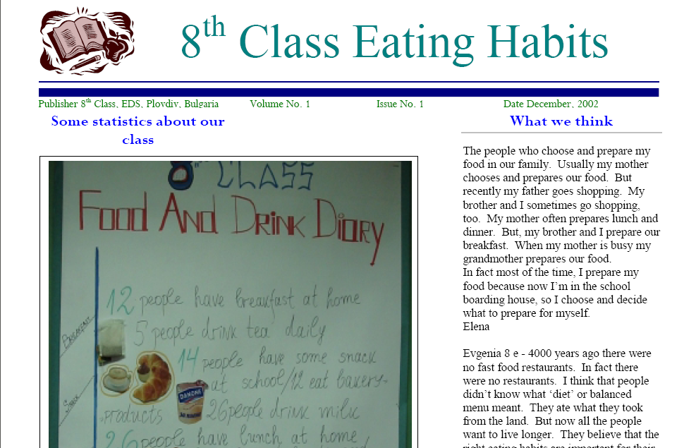
Sample Exchange Form - Bulgaria
Austrian partner school
Task 1 – What did you eat for breakfast?

Slide 16
Daily diet – habits and adverbs
Adverbs of frequency are used to show the frequency with which we perform actions. One of the most common uses of frequency adverbs is to talk about our habits.
When talking about our routine activities, we usually use these adverbs with the simple present tense. The most common frequency adverbs are: always, never, usually, sometimes, frequently, often and seldom.
Position - Frequency adverbs usually go in the middle. If there is an auxiliary verb, the frequency adverb goes after the auxiliary verb and before the main verb.
- We often have cereals for breakfast.
- I seldom eat snacks at school.
- She never eats bread with her meals.
- He sometimes has a cuppa with his lunch.
- I usually eat a big dinner.
- I frequently go without breakfast altogether.

Slide 17
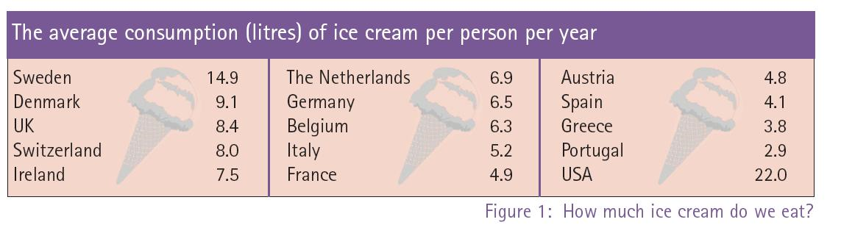
Who eats the most ice cream?

Slide 18
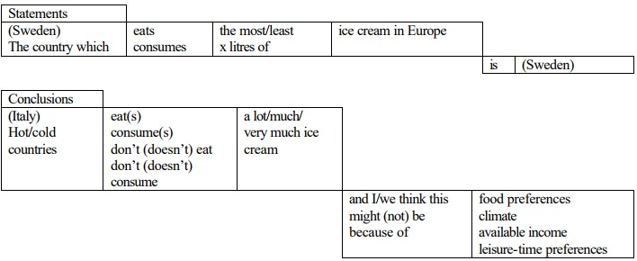
Analysing data - comparative / superlative adjectives / drawing conclusions

Slide 19
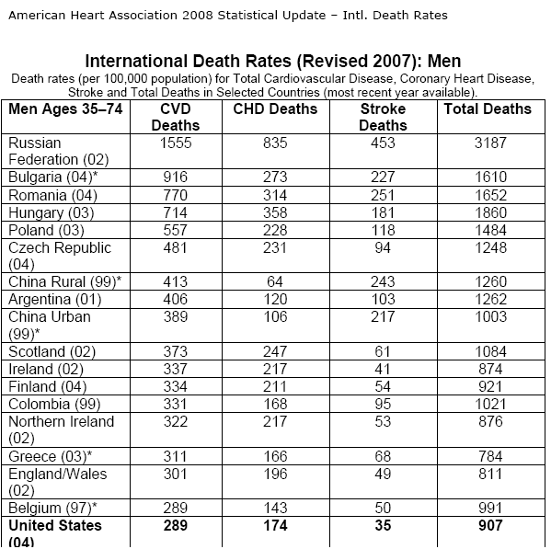
Researching Country Data - Bulgaria
Tasks:
2 - Speed test
3 - Accidents and deaths

Slide 20
Accidents and Deaths in Young People
‘Our information sheet gives statistics for injury deaths per 100, 000 in young people in Europe...
‘We can see that the lowest/highest/worst/best rate is in...
‘The death rate among boys is higher in all of the countries...boys are more accident prone than girls...
‘The chart shows that Western European countries have a high death rate caused by motor vehicles...
‘Countries of the former Soviet Union and of Eastern and Central Europe, on the other hand, have a low % of deaths on the road...
‘The countries of the former Soviet Union and Eastern Europe have higher death rates in general but...
‘Our conclusions are that perhaps there are fewer cars on the roads in the countries of the former Soviet Union and Eastern Europe and also that health facilities and provision may be at a higher level in western Europe and this would explain the lower death rate...

Slide 21
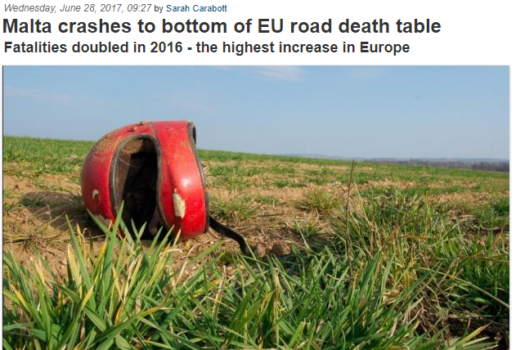
Road deaths in Malta

Slide 22
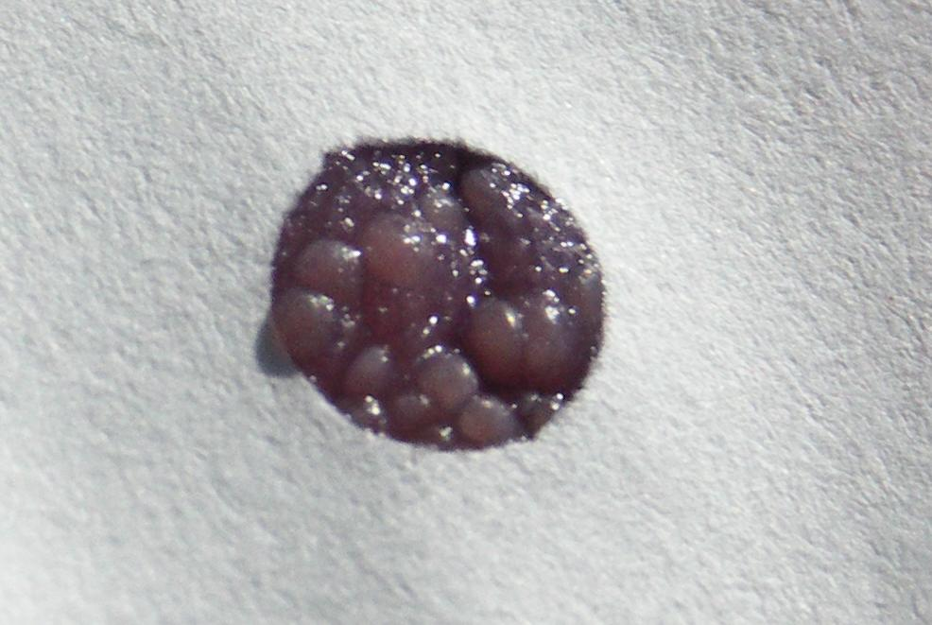
What is this?

Slide 23
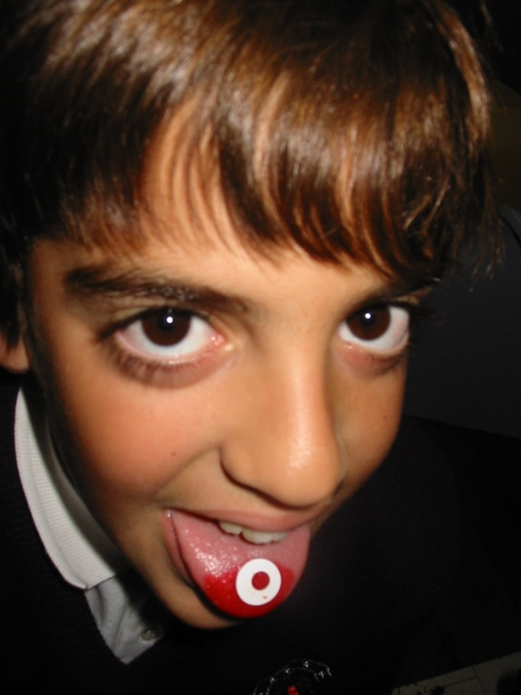
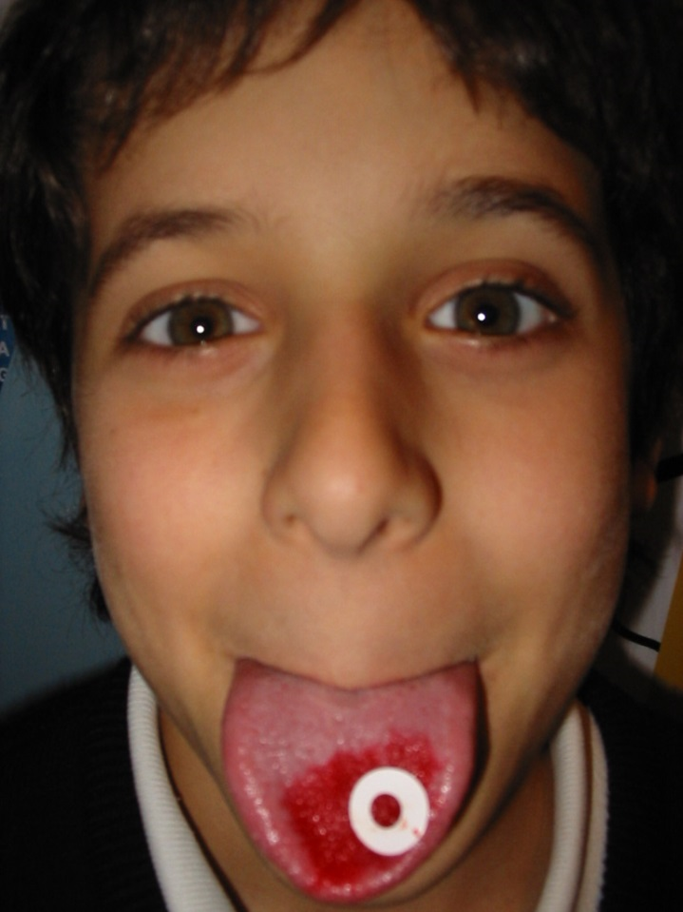

Taste buds

Slide 24
What can we survey in a group?
taste buds
height (gp 1)
hair colour (real hair colour!) (gp 2)
eye colour (gp 3)
skin colour
middle finger hair (gp 4)
earlobes: attached / not attached (gp 5)
tongue rolling (gp 6)
others:
shape of nose, shape of face, shoe size
Task 4 - Survey your group – poster

Slide 25
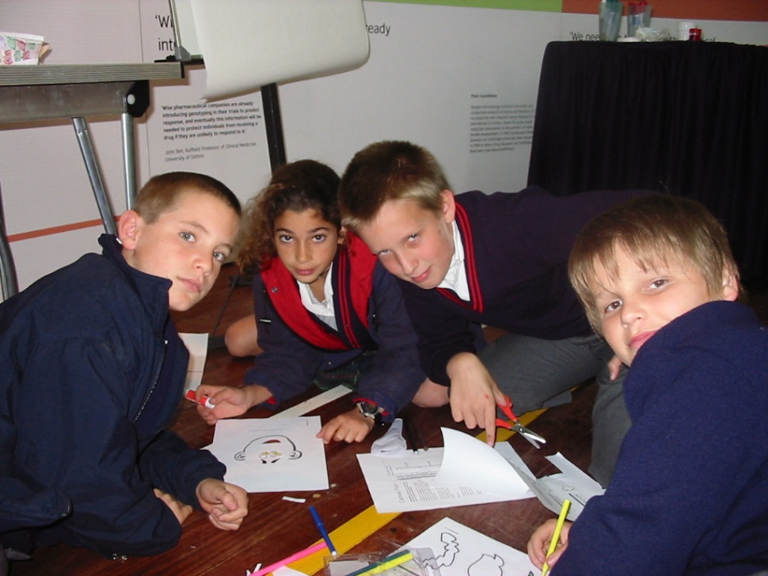
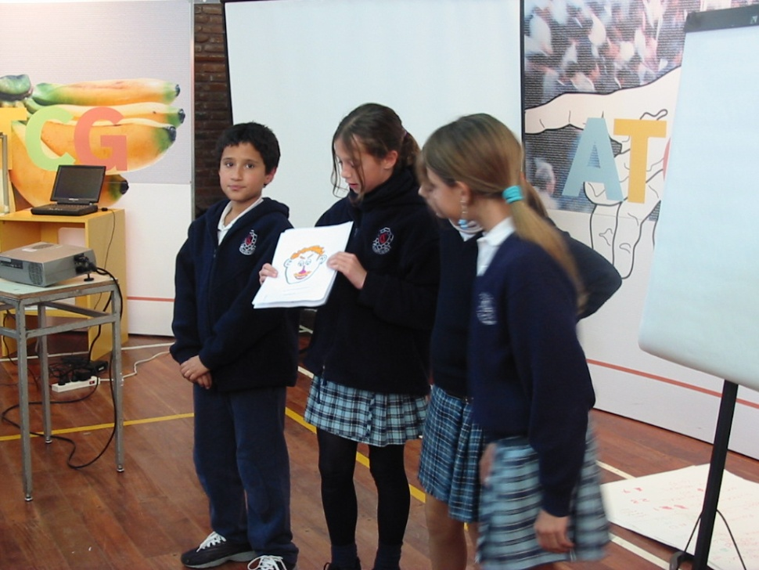
Your own GM person
… and present
Create … (original)

Slide 26
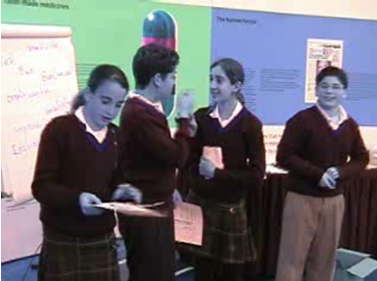
Product
This is our creation
Show us his face?
What's his name?
It’s Jimmy
His hair is from a Roman man
His nose is from his grandfather
The mouth is from his brother
Her eyes for his, grand er, his uncle
And the eyes, eyebrows, the eyebrush is from his brother and his mother and a little from his sister

Slide 27
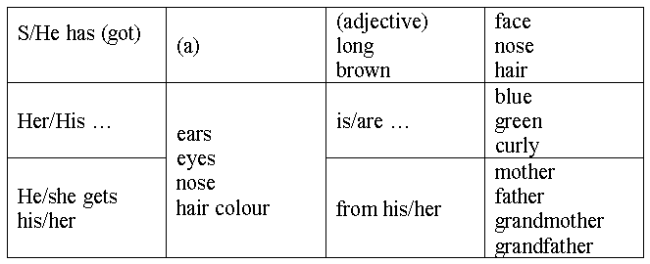
The language of heredity
Naming parts of the face
  Eyes, nose, ears, earlobes, eyebrows,
  hair, chin, cheeks
Describing inherited characteristics
He gets his … from his …
She gets her … from her …
He looks like his …
She looks like her …
He takes after his … with his
She takes after her … with her
He has inherited his mother’s …
She has inherited her mother’s …
Describing facial features
S/He has / has got
Her/His … is/are …
(brown, green, blue, blond, red, grey)
(round, thin, fat, long, short, flat,
curly, straight, spiky, wavy)
Task 5 - Who does your neighbour take after?

Slide 28
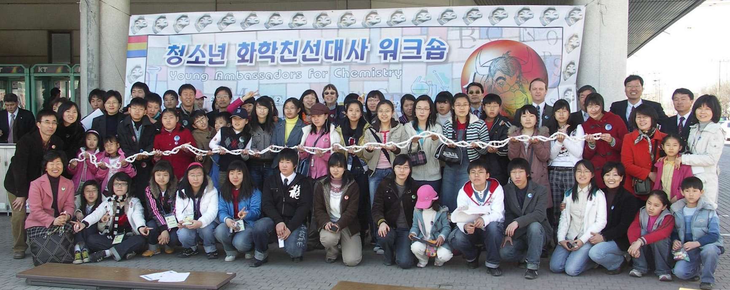

Korea
Taiwan

Slide 29
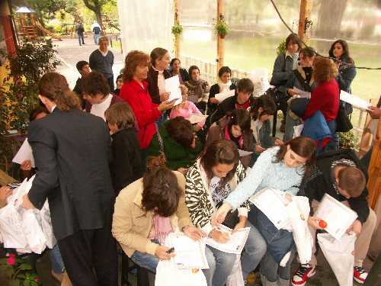
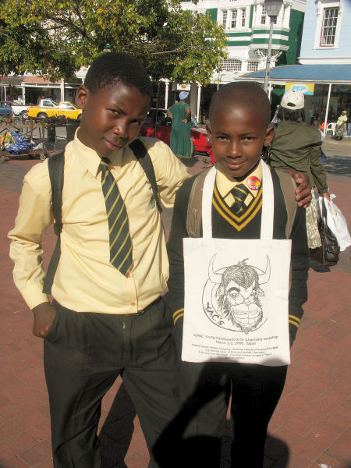
Argentina
South Africa

Slide 30
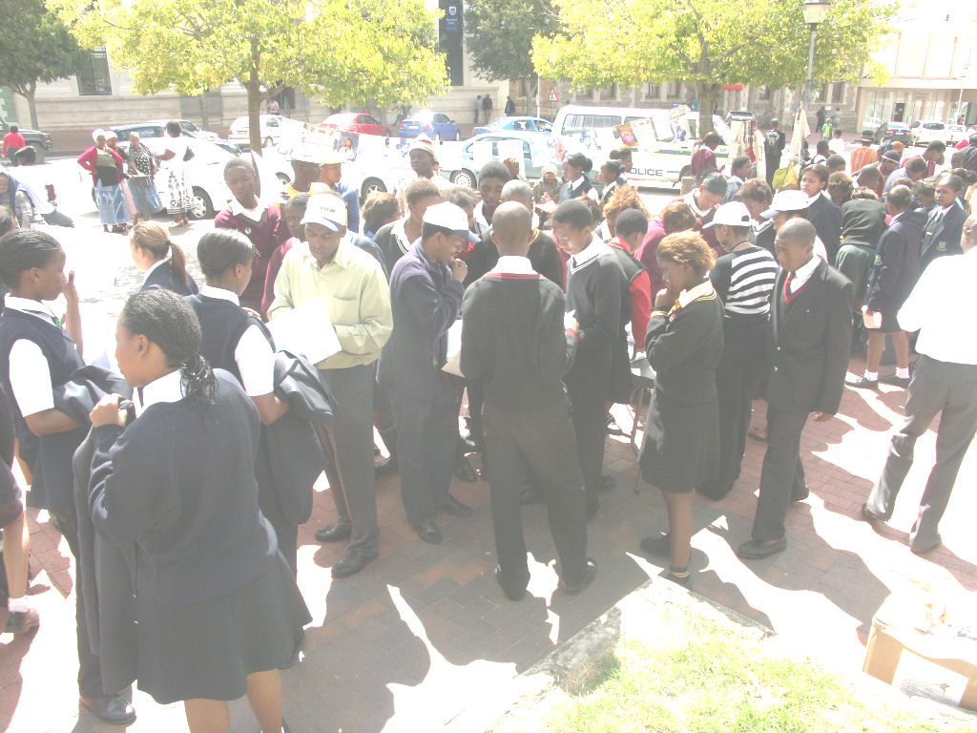
Grahamstown, South Africa, 2007
Young Ambassadors for Chemistry

Slide 31

Biodiversity – habitat and species loss

Slide 32
Cause and effect language
Verb phrases
Adverbs
Conjunctions
Noun phrases
Modals
Conditionals

Slide 33
‘causes’
verb phrase - 'causes'
Squeezing caused by the colliding plates causes faulting.
The rising water also causes landslides, triggering tsunamis.
Pressure causes the rock to fracture and there is an upward movement of land between parallel faults.
Joints are enlarged through chemical weathering and this causes the edges of the blocks to become rounded.
As well as adding to the weight of the material, water also causes some soil particles to swell.
This swelling causes nearby particles to move and it lubricates the soil, making it more likely to move downslope.

Slide 34
‘causes’ - structures
‘X’ causes | ‘y’ to be ________-ed
 | ‘y’ to + infinitive
 | a (noun phrase) (of ‘y’)

Slide 35
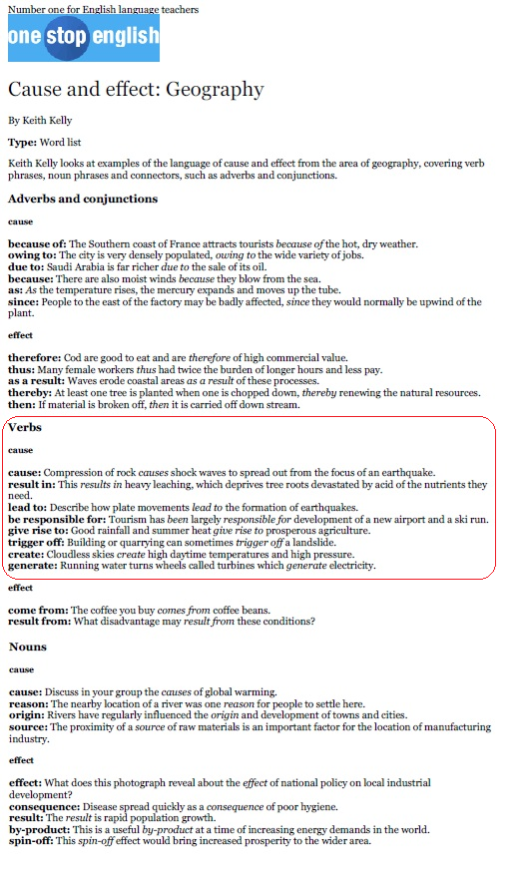
Cause and effect
verb phrases – cause
cause: Compression of rock causes shock waves to spread out from the focus of an earthquake.
result in: This results in heavy leaching, which deprives tree roots devastated by acid of the nutrients they
need.
lead to: Describe how plate movements lead to the formation of earthquakes.
be responsible for: Tourism has been largely responsible for development of a new airport and a ski run.
give rise to: Good rainfall and summer heat give rise to prosperous agriculture.
trigger off: Building or quarrying can sometimes trigger off a landslide.
create: Cloudless skies create high daytime temperatures and high pressure.
generate: Running water turns wheels called turbines which generate electricity.

Slide 36
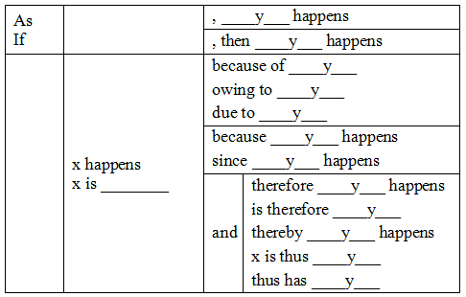
cause-effect adverbs and conjunctions

Slide 37
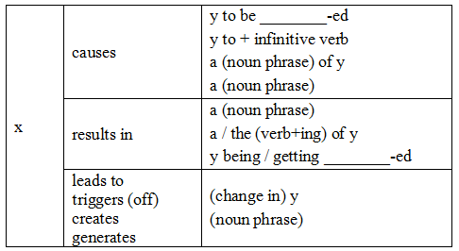
cause-effect verbs

Slide 38
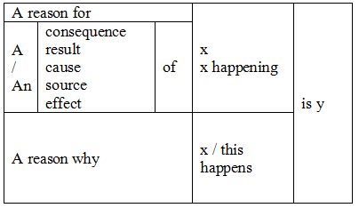
cause-effect noun phrases

Slide 39
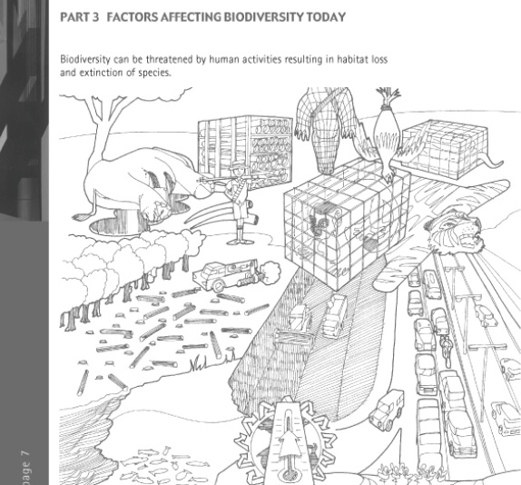
Biodiversity – habitat and species loss
Task 6 – Discuss the causes and consequences of habit loss on Earth

Slide 40
TrashedWorld
Data handling – analysing / concluding / presenting
Interviewing – direct / indirect questions
  (talking to the public, businesses, officials)
Lobbying – formal letter writing
  (writing to corporates and municipalities)
TrashedWorld summary

Slide 41
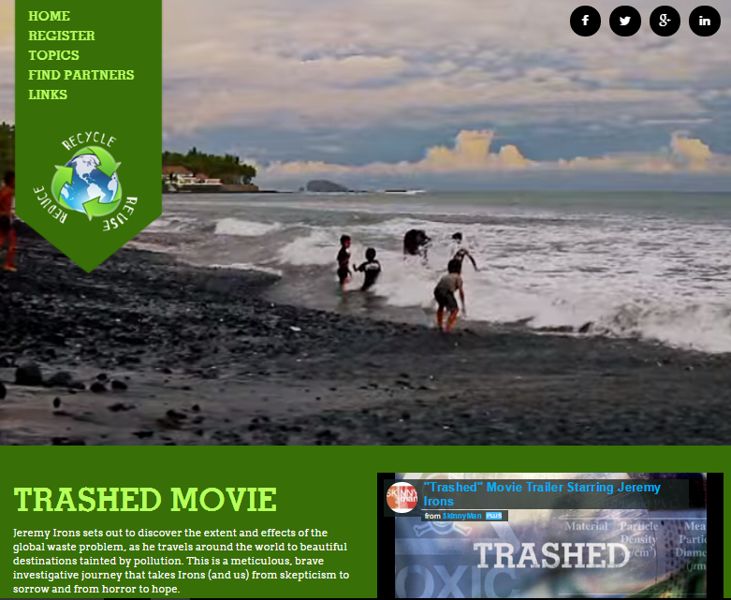
1 TrashedWorld – exchange about waste
Launched January 2016 now with 450 schools in 65 countries around the world.
www.trashedworld.com

Slide 42
TrashedWorld – exchange about waste
Explore locally
  Your own life
  Your family’s life
  Your school, community, town
  Your country
Exchange globally
  Students in another country
  Their family’s life
  Their school, community, town
  Their country

Slide 43
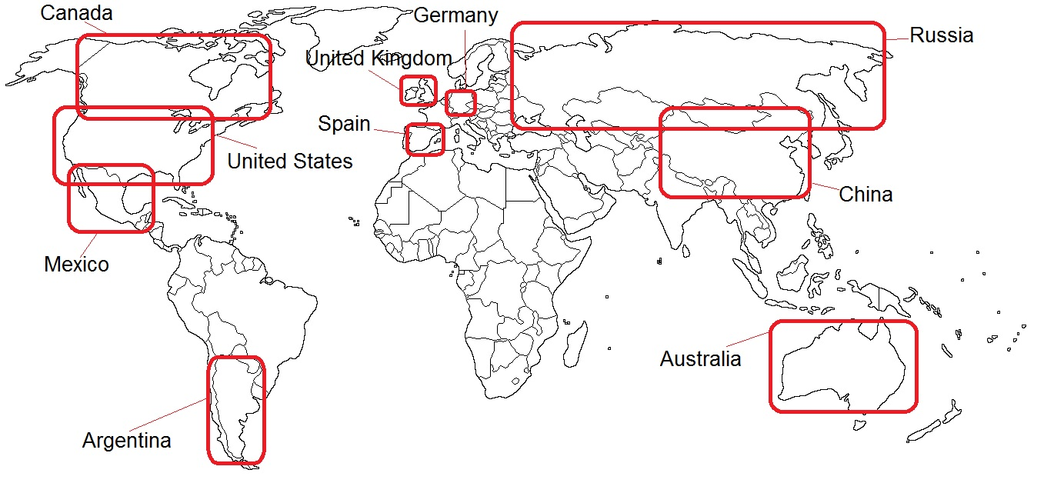
TrashedWorld – exchange about waste

Slide 44
TrashedWorld – exchange about waste
USA – 230m tonnes per year
China – 300m tonnes per year
Russia – 200m tonnes per year
Germany – 51m tonnes per year
UK – 31m tonnes per year
Mexico – 39m tonnes per year
Spain – 21m tonnes per year
Australia – 14m tonnes per year
Argentina – 14m tonnes per year
Canada – 27m tonnes per year

Slide 45
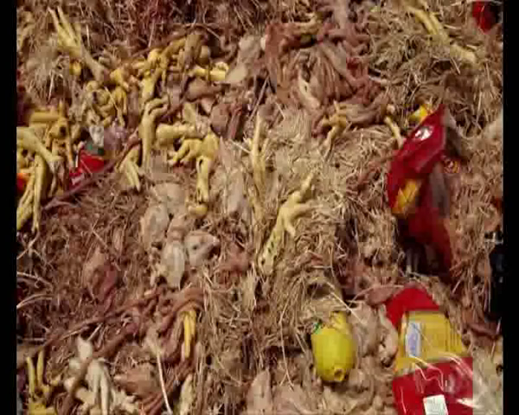
Exchange content projects
  Lebanon

Slide 46
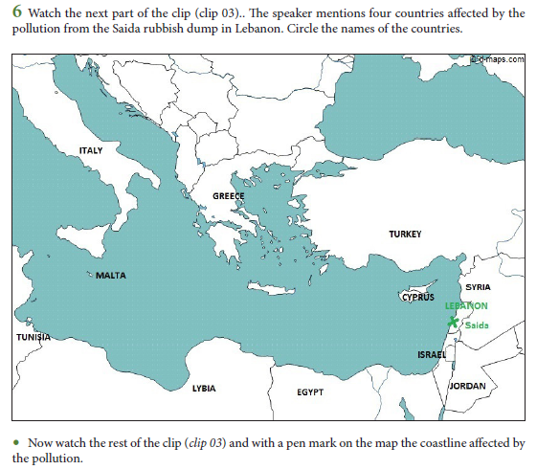
Exchange content projects
  Lebanon

Slide 47
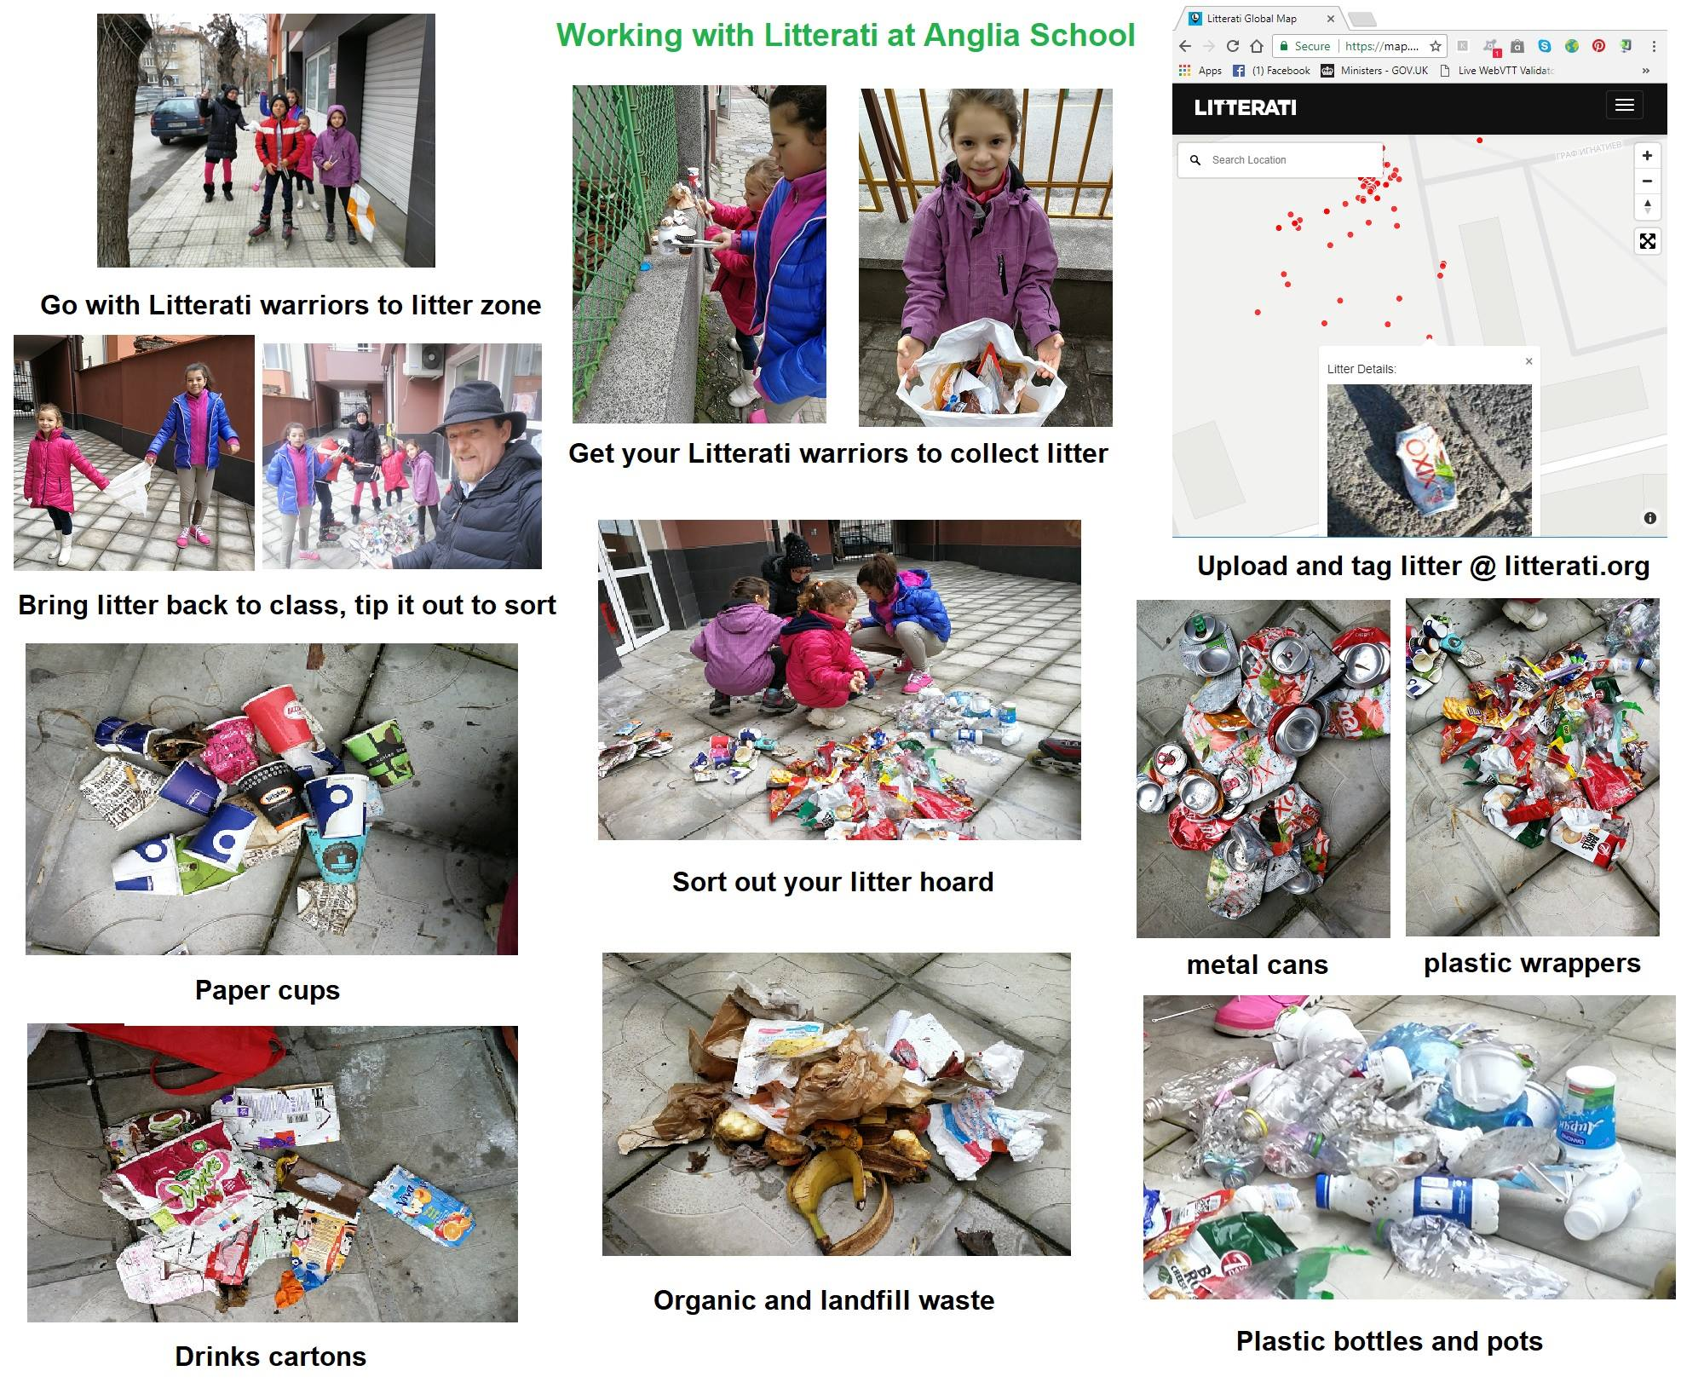
PS – ‘Litterati’ – write to the producers

Slide 48
Conclusions:
Place language in meaningful skills work…
(and you make connections with wider curriculum)
1 Verbal communication
2 Teamwork
3 Commercial awareness
4 Analysing and investigating
5 Initiative / Self-motivation
6 Drive
7 Written communication
8 Planning & organising
9 Flexibility
10 Time management
global skills
negotiating & persuading
leadership
numeracy
computing skills
self-awareness
confidence
lifelong learning
stress tolerance
integrity
independence
developing professionalism
action planning
decision-making
interpersonal sensitivity
creativity

Slide 49
Links
factworld@yahoogroups.com
e-group with 3500+ teachers around the world
www.factworld.info
(Forum for Across the Curriculum Teaching)
www.scienceacross.org
Science Across the World
www.trashedworld.com
TrashedWorld

