Slide 1
Austrian CLIL
The story so far
(asking the right questions, and making the right decisions in schools)
keithpkelly@yahoo.co.uk

Slide 2
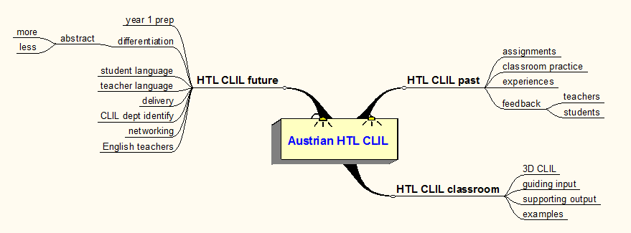
HTL CLIL - the story so far

Slide 3
HTL CLIL past – @ PH Wien
Module 1
  Subject-specific vocabulary
  Guiding students through input
    Multi-media input (PPT, film, animation, poster, object, talk, demo)
    Text input
  Assignment 1 – develop one or two activities within a lesson (online support)
Module 2
  General academic language
  Supporting students’ output
    Supporting writing
    Supporting talk
  Assignment 2 – develop one or two activities within a lesson (online support)
Module 3
  Sequencing
Module 4
  Portfolios
Notes:
There was a decision not to grade the assignments. It was the right decision, and it still is.
I am frequently asked to proof read what is essentially lesson material which has been written as translation from German to English. In this context, I proof read the material and I make suggestions as to how the vocab can be organized, how the general academic language can be embedded in task, how to guide input, how to support output, but essentially there is no comeback if the teacher decides that they will essentially ‘deliver’ what they normally do in German, in English.

Slide 4
HTL CLIL past – classroom practice
Classroom dynamics
  Teacher experience and language ability
  What goes on in the classroom?
  What exactly students are asked to do (teachers?)
  Students won’t develop oral competence, if they don’t speak in class
  Subject / profession demands spoken skills, students should speak in class
  A balance of skills?
  Unwrapping curriculum objectives
    What does ‘analyse’ mean?
    What does ‘know’ mean?
Notes:
A student can only really know what has been taught, if they are asked to express this knowledge in spoken or written form, or do, produce something based on the input content, as a result of what they have been taught.

Slide 5
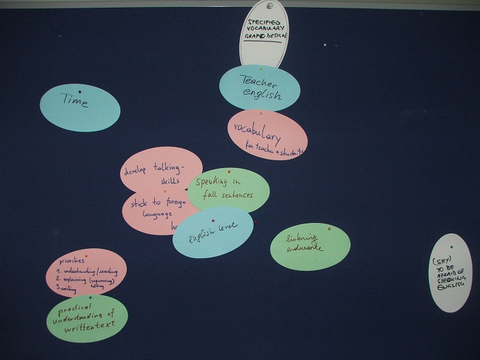
HTL CLIL past – feedback
Needs

Slide 6
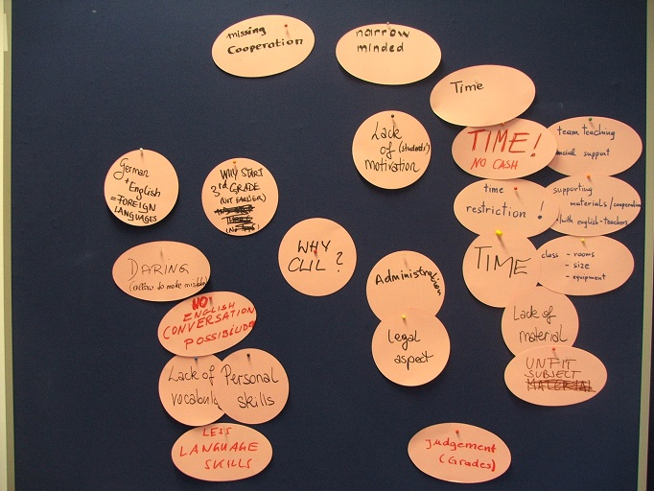
HTL CLIL past – feedback
Challenges

Slide 7
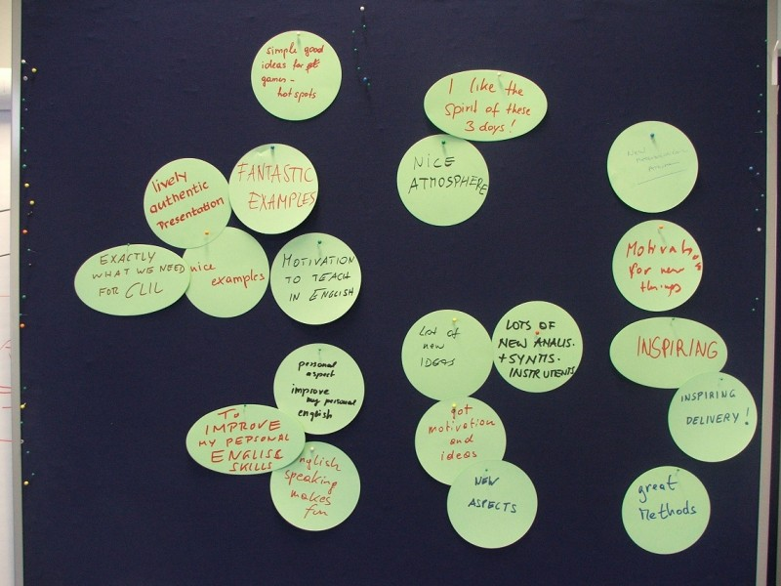
HTL CLIL past – feedback
Benefits

Slide 8
HTL CLIL in the classroom
Students ‘doing’ things
One colleague describes his classes in the following way:
'All these techniques are fine where the students actually do things in the lessons, in my classes the students don't do anything. They listen to my input and explanations of the theory.

Slide 9
HTL CLIL in the classroom
Red flag!
CLIL is about method, and dynamics. Where a lesson goal is to deliver theory through teacher talk, the dynamic is restricted to that medium.
Is such a context the best one to use a foreign language? Where teachers are confident in the foreign language, and the students are confident in the foreign language (this means that they are able to follow a foreign-language theoretical lecture, take notes, apply the theory to subsequent practice), there is a role for this approach.
Beware of dedicating significant numbers of CLIL hours in the timetable to this kind of teaching.
In subjects heavy in theoretical content, look for areas of the curriculum which lend themselves to developing communicative skills and avoid the areas of abstract content. Feel confident NOT to teach in English.

Slide 10
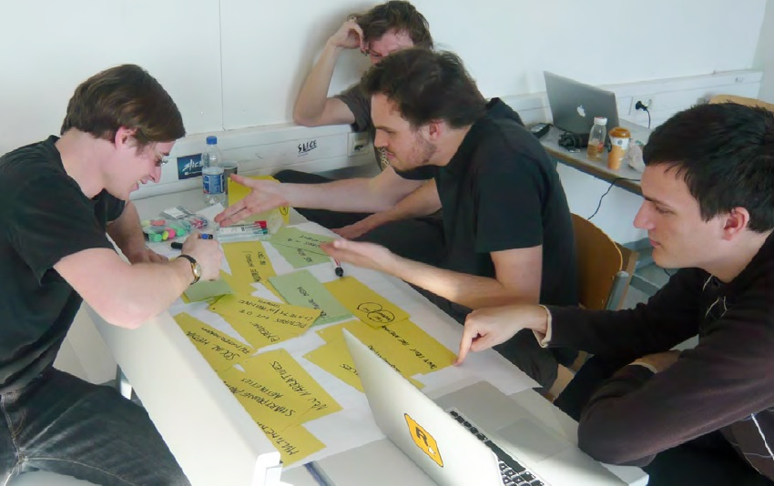
HTL CLIL in the classroom
Good practice

Slide 11
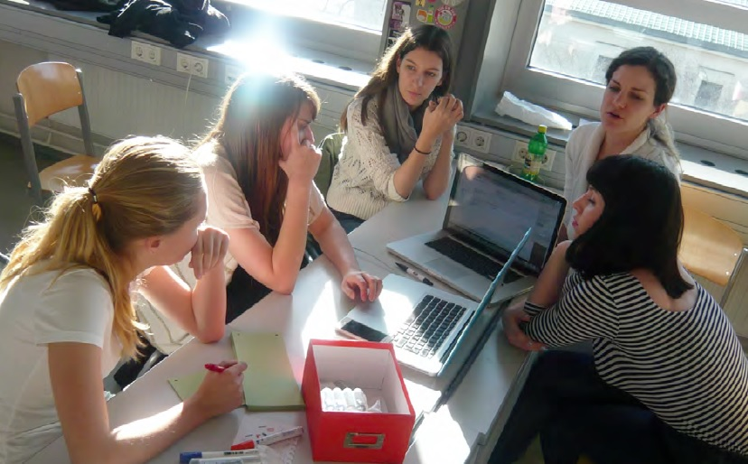
HTL CLIL in the classroom
Good practice

Slide 12
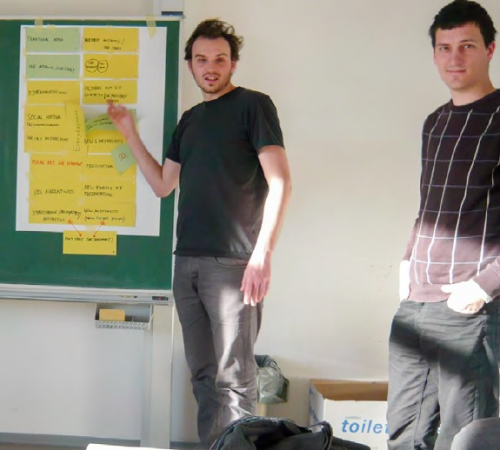
HTL CLIL in the classroom
Good practice

Slide 13
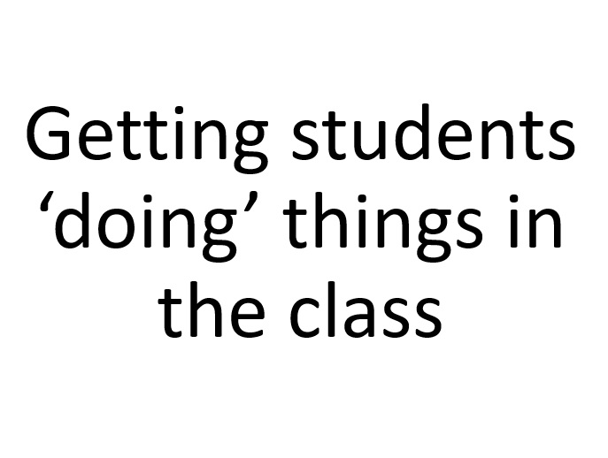
HTL CLIL in the classroom
Good practice

Slide 14
HTL CLIL in the classroom
Turning the course curriculum into classroom practice
  Examples: subject-specific vocabulary
  Examples: guiding input media
  Examples: guiding input text
  Examples: general academic language
  Examples: supporting written output
  Examples: supporting spoken output

Slide 15
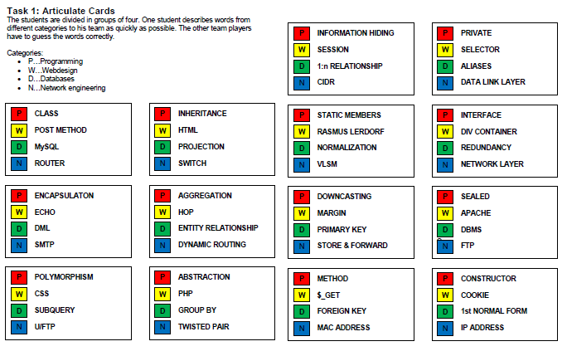
Subject-specific vocabulary – Software devpt

Slide 16
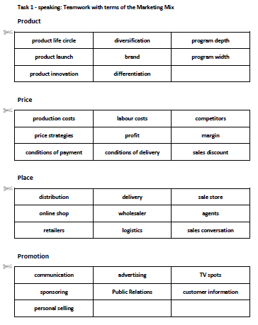
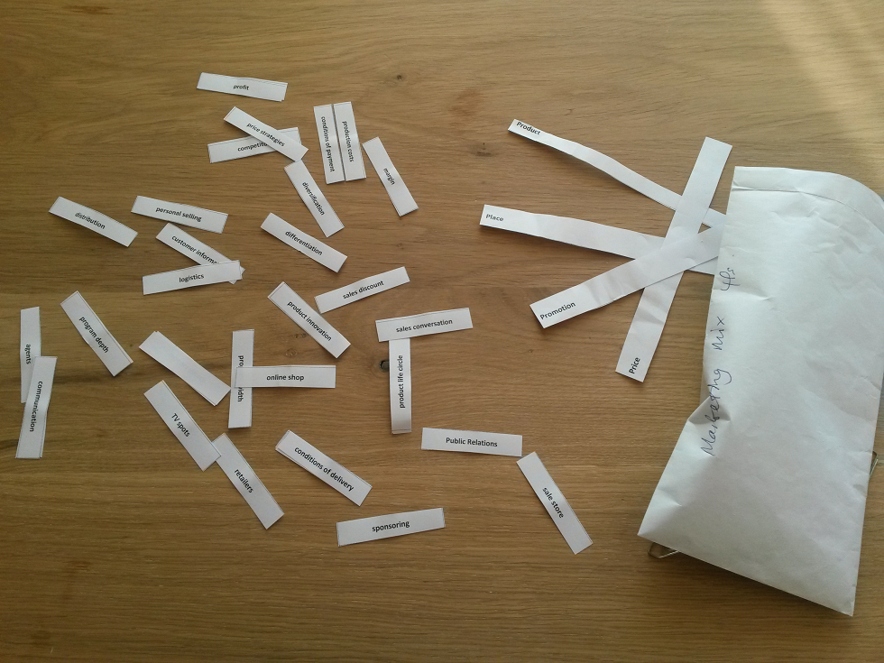
‘Doing’ terminology

Slide 17
HTL CLIL in the classroom
Turning the course curriculum into classroom practice
  Examples: subject-specific vocabulary
  Examples: guiding input media
  Examples: guiding input text
  Examples: general academic language
  Examples: supporting written output
  Examples: supporting spoken output

Slide 18
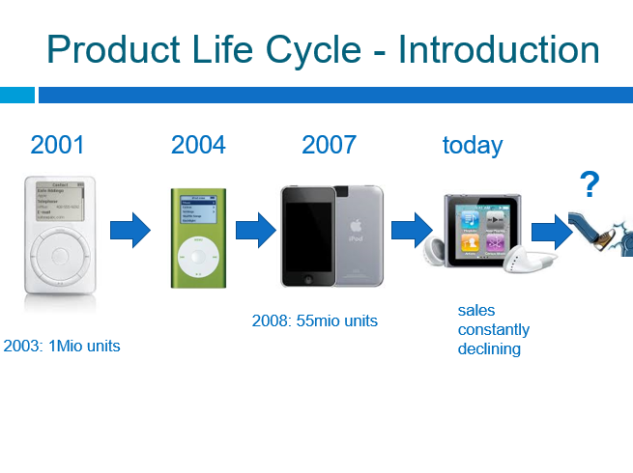
A product life-cycle

Slide 19

Product Life Cycle – Task Group A

Slide 20
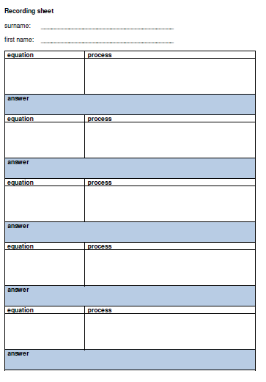
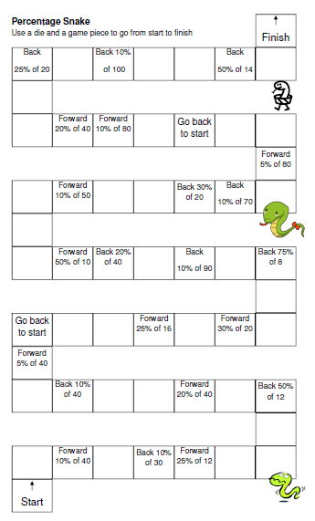
Guiding input media
Board game - ‘Percentage Snake’

Slide 21
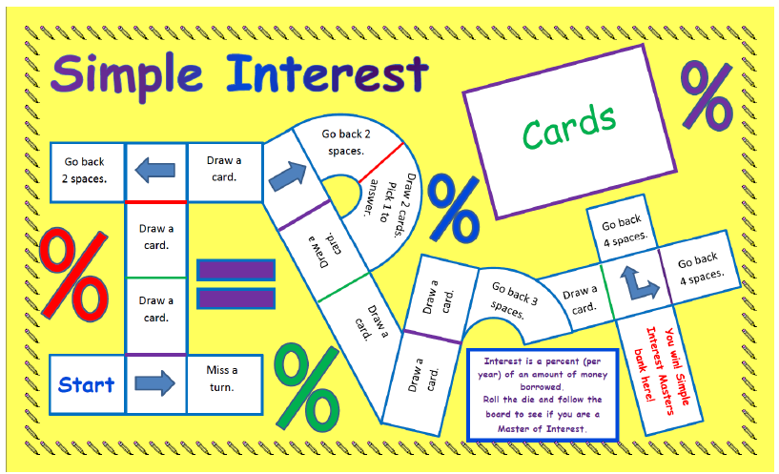
Guiding input media – Simple Interest Board game

Slide 22
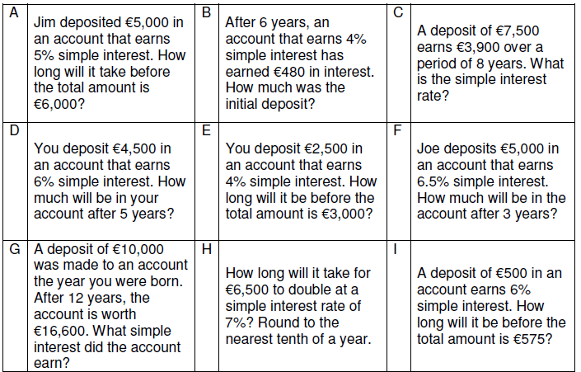
Guiding input media - Simple interest cards

Slide 23
HTL CLIL in the classroom
Turning the course curriculum into classroom practice
  Examples: subject-specific vocabulary
  Examples: guiding input media
  Examples: guiding input text
  Examples: general academic language
  Examples: supporting written output
  Examples: supporting spoken output

Slide 24
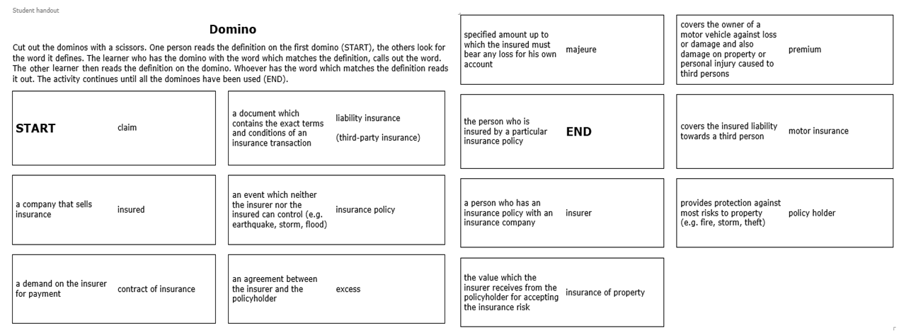
Guiding input text – Insurance Dominoes

Slide 25

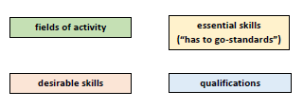
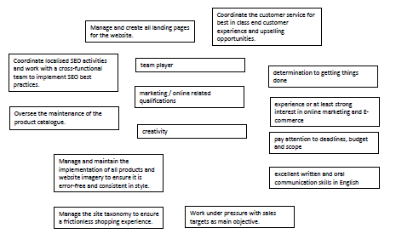
Guiding input text – Job Specs

Slide 26
HTL CLIL in the classroom
Turning the course curriculum into classroom practice
  Examples: subject-specific vocabulary
  Examples: guiding input media
  Examples: guiding input text
  Examples: general academic language
  Examples: supporting written output
  Examples: supporting spoken output

Slide 27
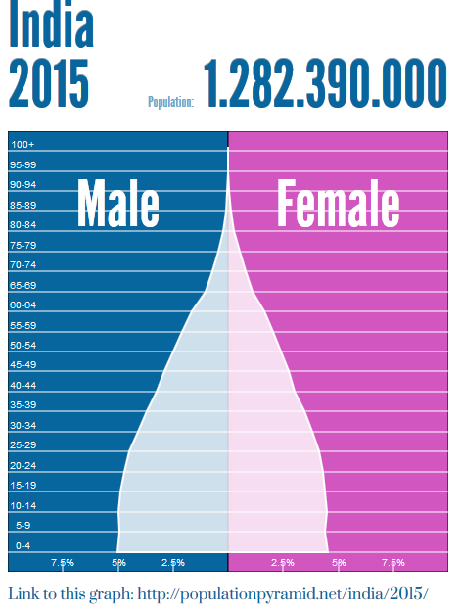
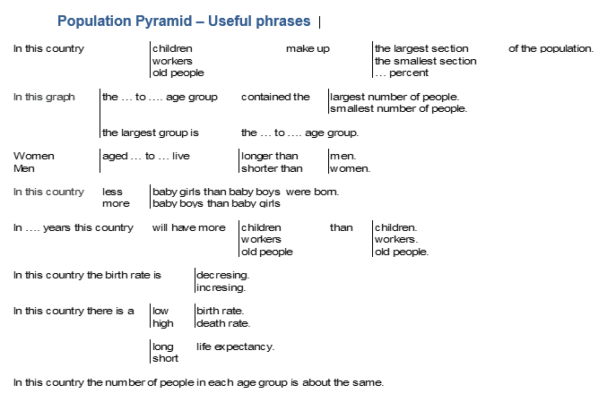
General academic language – Population pyramids

Slide 28
HTL CLIL in the classroom
Turning the course curriculum into classroom practice
  Examples: subject-specific vocabulary
  Examples: guiding input media
  Examples: guiding input text
  Examples: general academic language
  Examples: supporting written output
  Examples: supporting spoken output

Slide 29
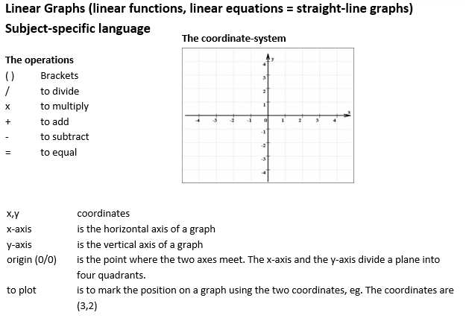
Supporting written output –
More than subject-specific vocabulary

Slide 30
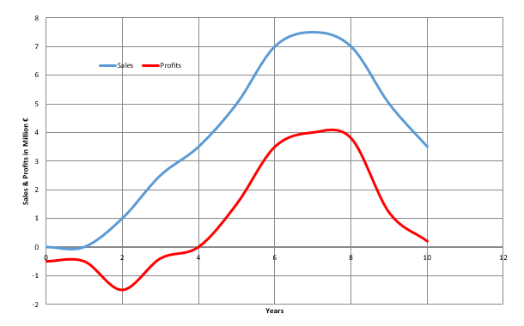
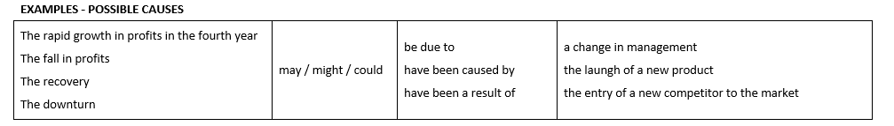
Supporting written output –
Product life cycle

Slide 31
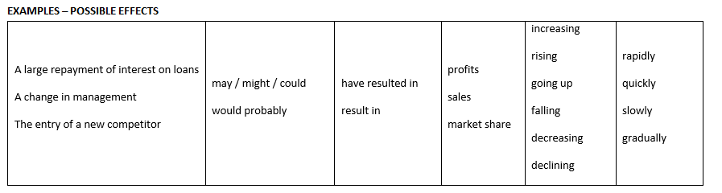
Supporting written output –
Product life cycle

Slide 32
HTL CLIL in the classroom
Turning the course curriculum into classroom practice
  Examples: subject-specific vocabulary
  Examples: guiding input media
  Examples: guiding input text
  Examples: general academic language
  Examples: supporting written output
  Examples: supporting spoken output

Slide 33
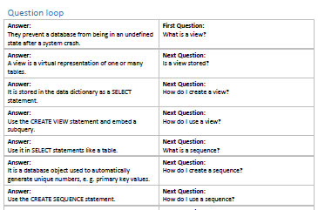
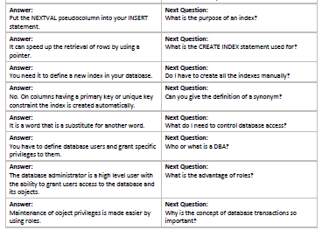
Supporting talk - Special SQL Topics

Slide 34
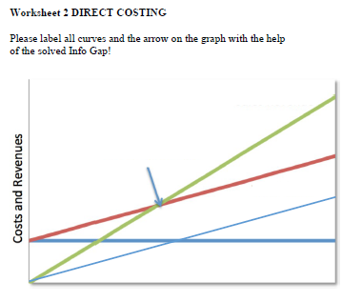
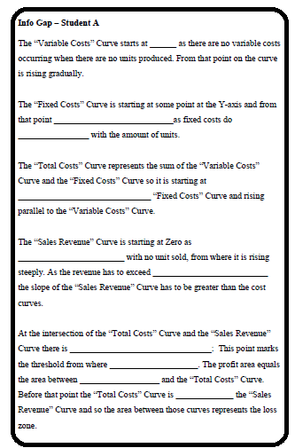
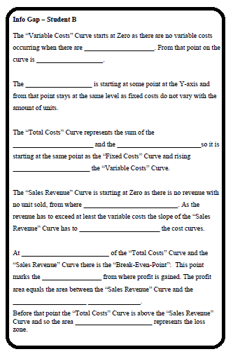
Supporting spoken output –
Direct costing

Slide 35
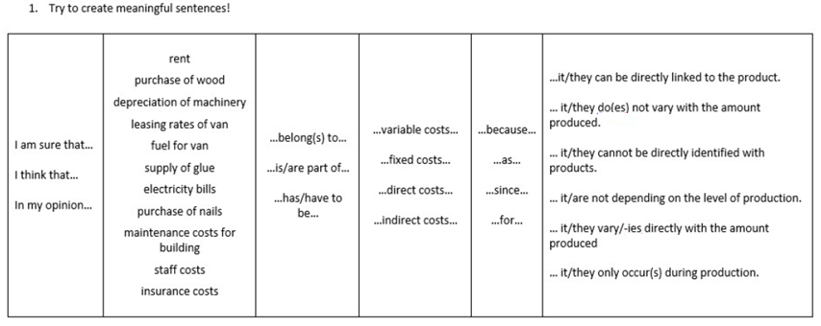
Supporting spoken output –
Direct costing

Slide 36
HTL CLIL future – The way ahead in 10 steps
Start in Grade 1
  and/or develop academic language in English lessons
Set up systems for monitoring student language levels
Which teachers should attend professional development?
Decide on ‘didactic methods’ to be expected in class
  Where possible develop skills using a CLIL approach (guiding input, supporting output)
  Where ‘lectures’ are given, make them visual, guided, interactive, language-salient
Decide ‘not’ to teach certain subjects in English if conditions dictate
Create a CLIL identify in school, space (physical/online), time, groups
Encourage colleagues to ‘explore’ and ‘innovate’ (it’s a learning process)
Publish your material (share)
Manage CLIL on a school basis (not individual teachers)
Grow the CLIL network in Austria and beyond

Slide 37
HTL CLIL future
CLIL Conference 2019? (School-based approaches to CLIL)
Schools and colleagues (students?) reporting back on their experiences
‘When I asked the students for a general feedback some of them where actually asking for more lessons in English language and so I found that very encouraging'.

