Slide 1
Fieldwork in Geography –
Bilingual teaching
James Hindson
Sense&Sustainability
The world is in a serious mess!

Slide 2
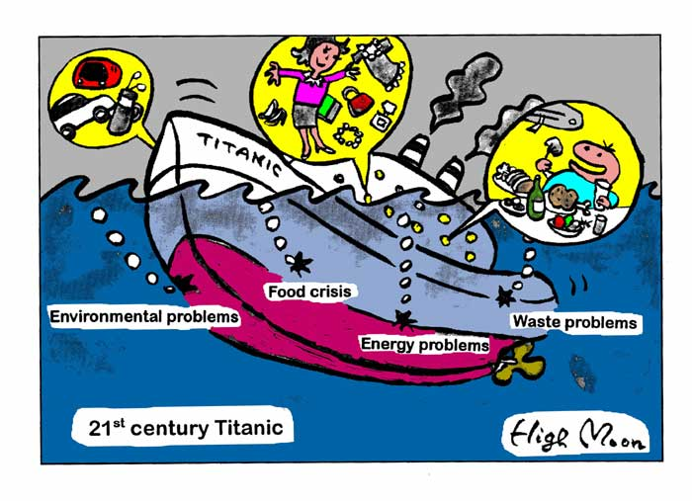
Fieldwork in Geography bilingual teaching
Torun 2nd – 4th October 2009
There is no doubt the world is in a mess

Slide 3
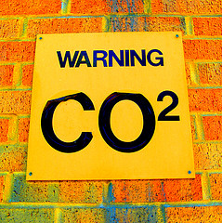
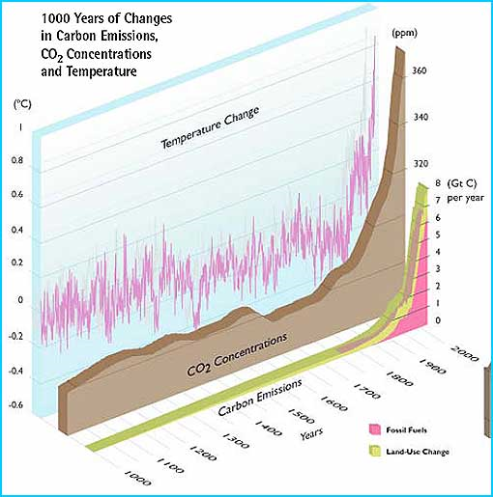
Fieldwork in Geography bilingual teaching
Torun 2nd – 4th October 2009
There is a triple crunch!
Climate change

Slide 4
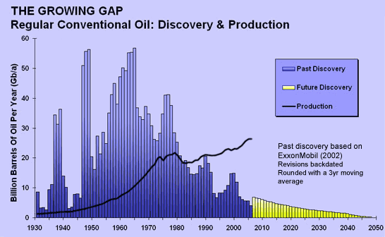
Fieldwork in Geography bilingual teaching
Torun 2nd – 4th October 2009
Peak Oil

Slide 5
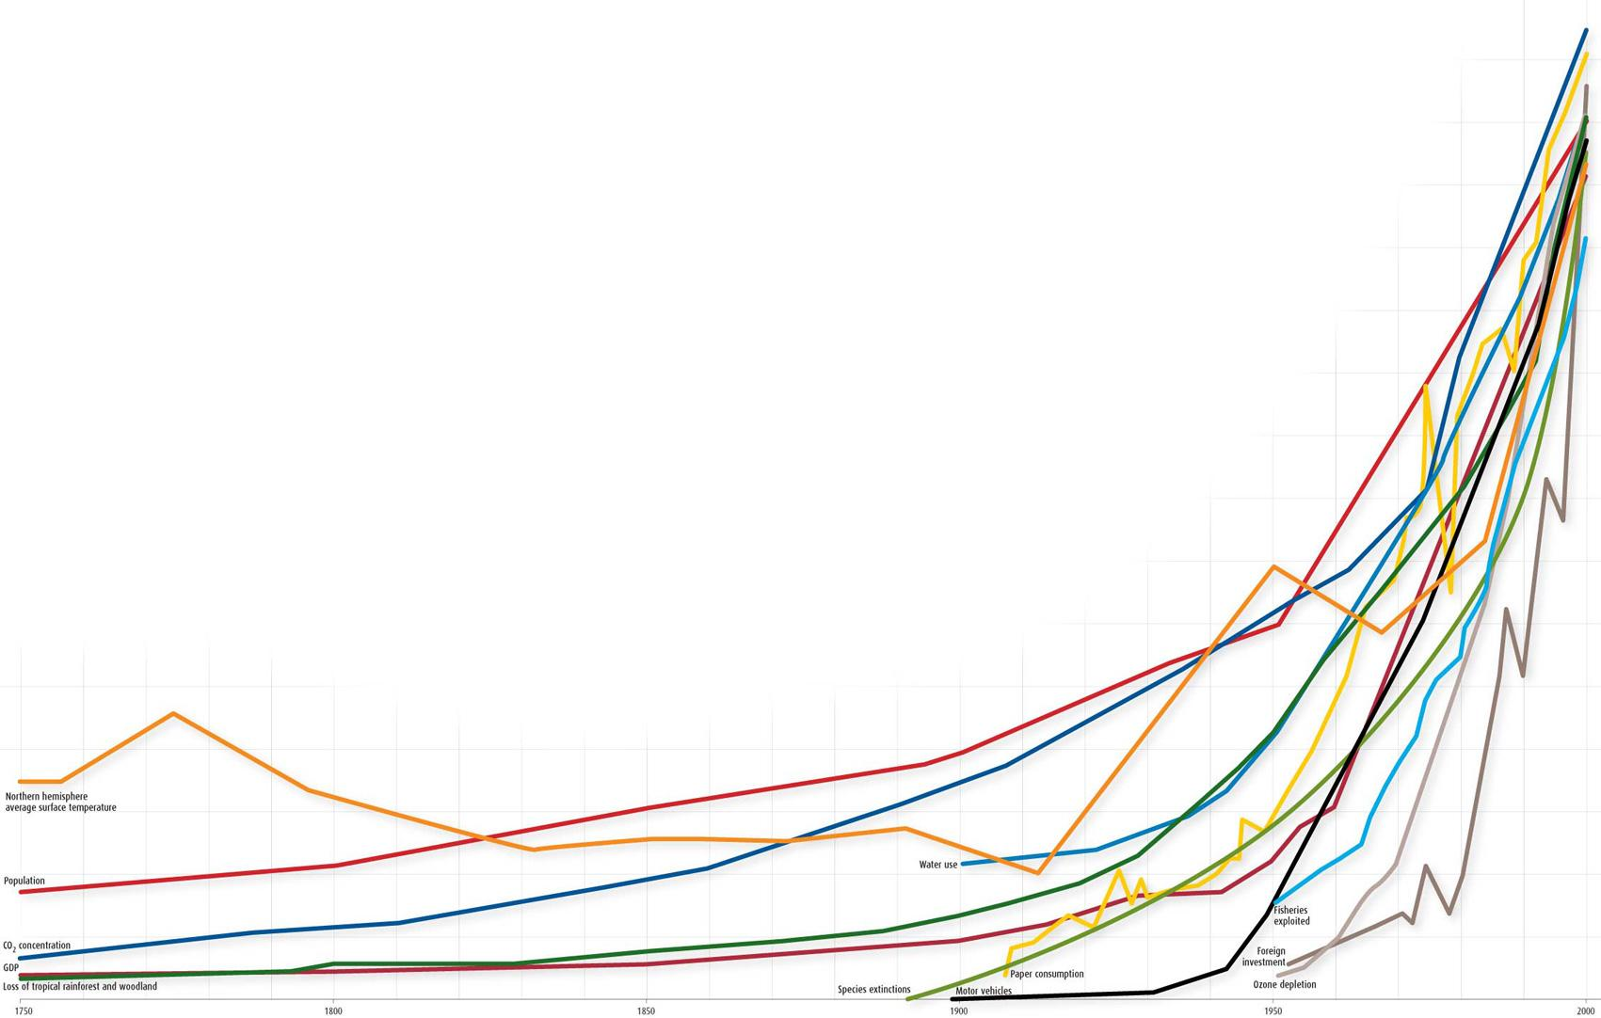
Fieldwork in Geography bilingual teaching
Torun 2nd – 4th October 2009
System Stress

Slide 6
Fieldwork in Geography bilingual teaching
Torun 2nd – 4th October 2009
Biodiversity

Slide 7
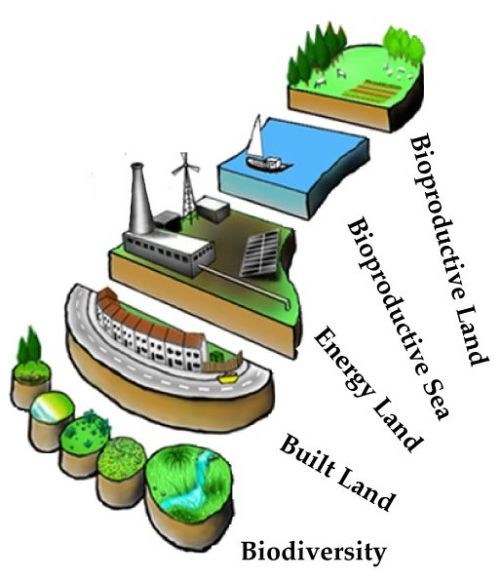
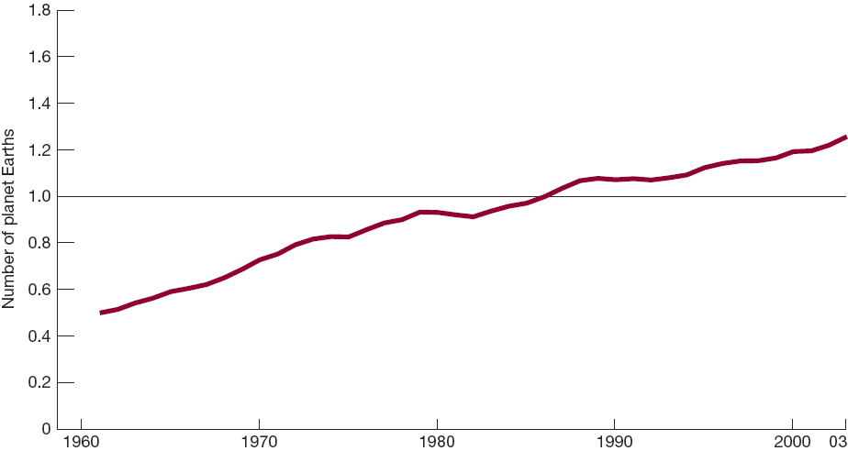
Fieldwork in Geography bilingual teaching
Torun 2nd – 4th October 2009
Beyond our limits

Slide 8
Fieldwork in Geography bilingual teaching
Torun 2nd – 4th October 2009
The equation of unsustainability
I = P x C x T
Impact in the environment =
Population x Consumption x Technological Efficiency

Slide 9
Fieldwork in Geography bilingual teaching
Torun 2nd – 4th October 2009
If TODAY
1 = 1 x 1 x 1
In 2050
1 = 1.5 x 3 x X
What is X?

Slide 10
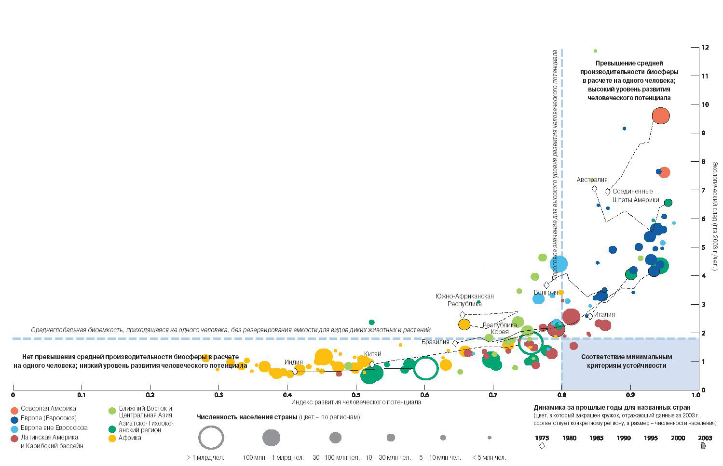
Fieldwork in Geography bilingual teaching
Torun 2nd – 4th October 2009
Unequal shares

Slide 11
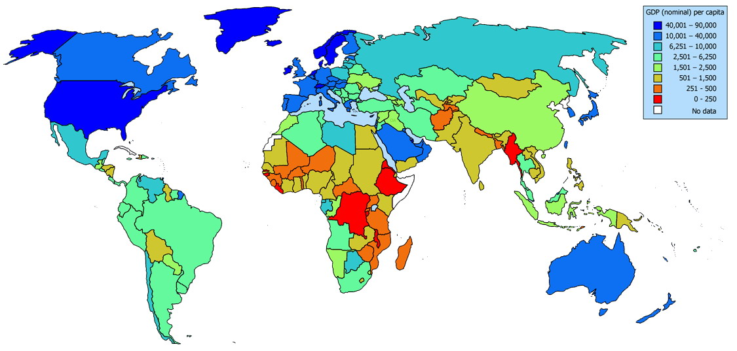
Fieldwork in Geography bilingual teaching
Torun 2nd – 4th October 2009

Slide 12
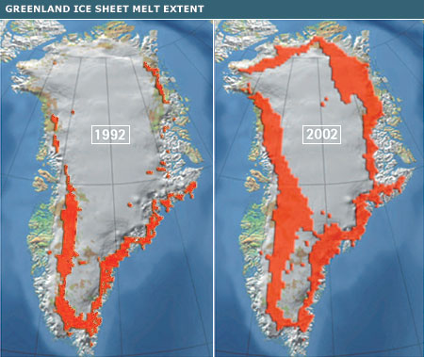
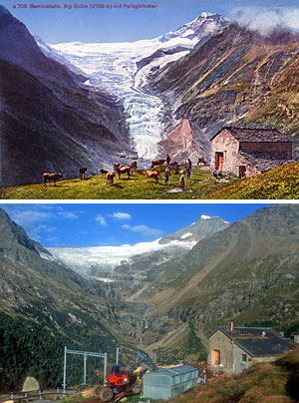
Fieldwork in Geography bilingual teaching
Torun 2nd – 4th October 2009
And it’s all getting worse faster

Slide 13
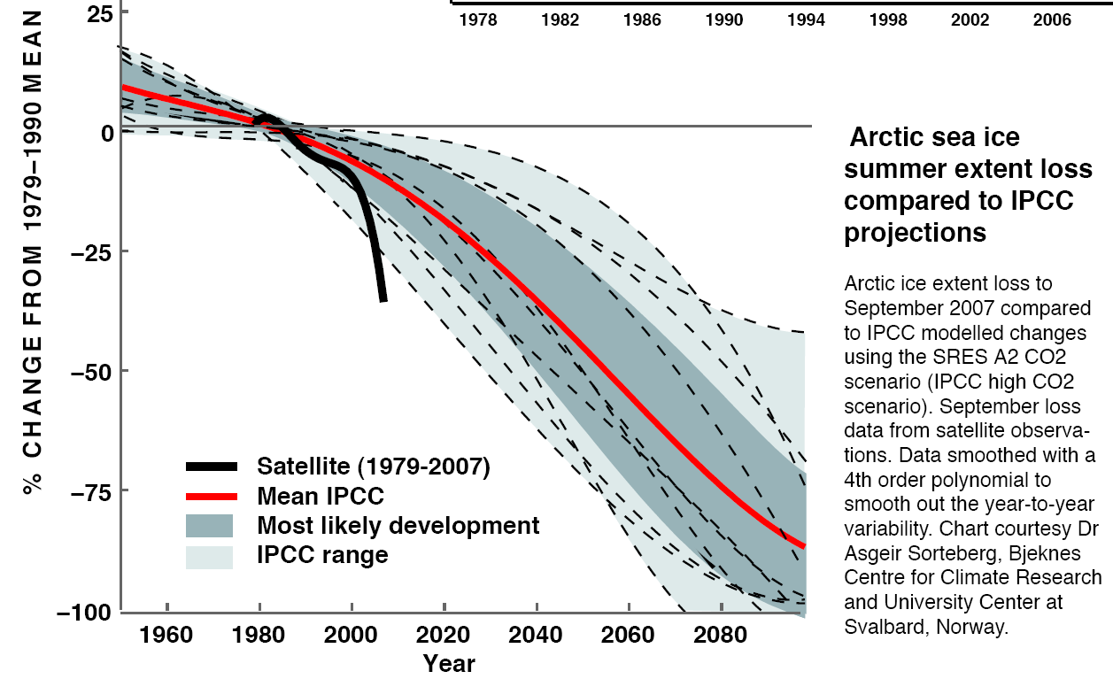
Fieldwork in Geography bilingual teaching
Torun 2nd – 4th October 2009

Slide 14

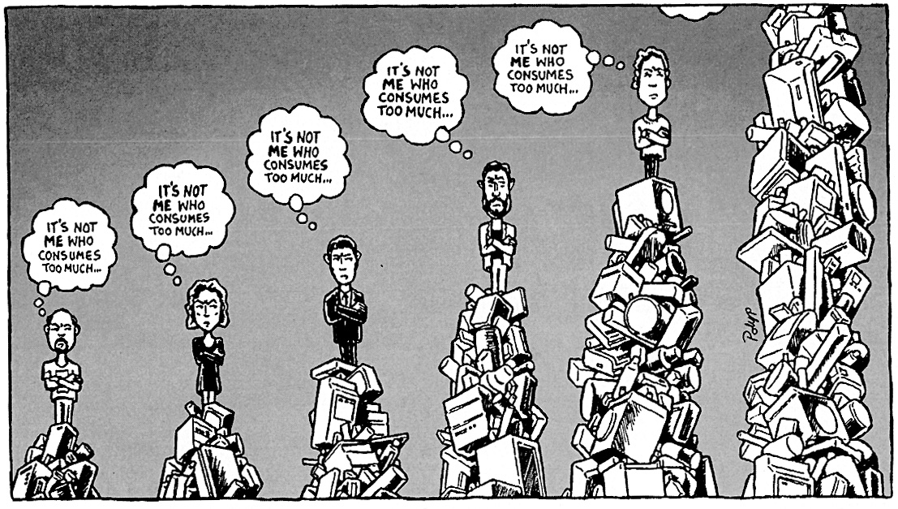
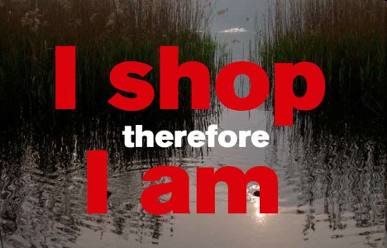
Fieldwork in Geography bilingual teaching
Torun 2nd – 4th October 2009
So Why?

Slide 15

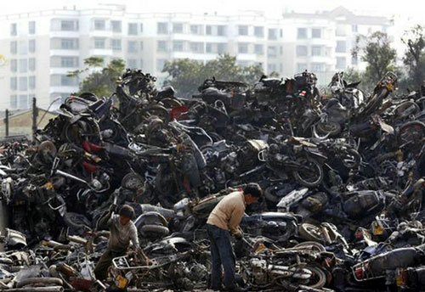
Fieldwork in Geography bilingual teaching
Torun 2nd – 4th October 2009

Slide 16
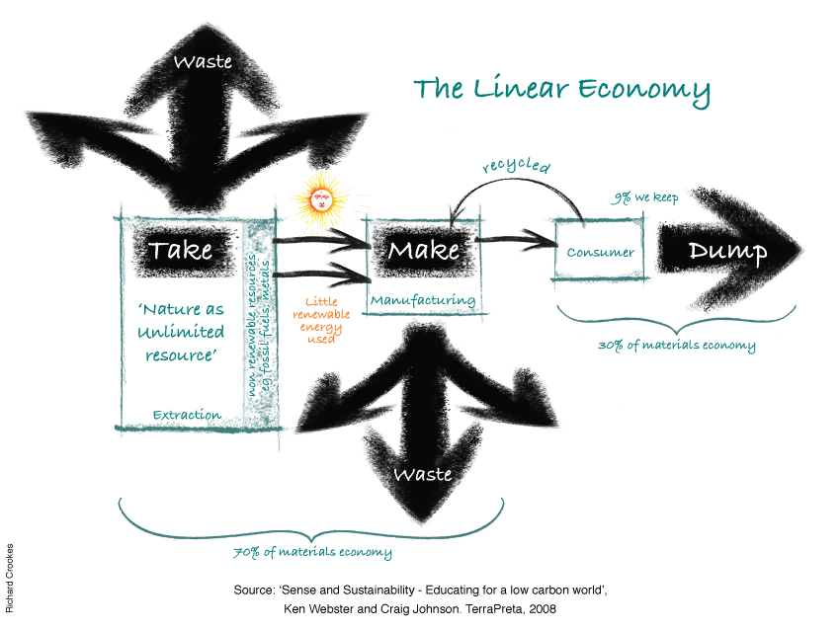
Fieldwork in Geography bilingual teaching
Torun 2nd – 4th October 2009
What is at the heart of the problem?

Slide 17
Fieldwork in Geography bilingual teaching
Torun 2nd – 4th October 2009
This is a system that
Puts billions of kilogram of toxic material into the air, water, and soil every year
Produces some materials so dangerous they will require constant vigilance by future generations
Results in gigantic amounts of waste
Puts valuable materials in holes all over the planet, where they can never be retrieved
Requires thousands of complex regulations to keep people and natural systems from being poisoned too quickly

Slide 18
Fieldwork in Geography bilingual teaching
Torun 2nd – 4th October 2009
Measures productivity by how few people are working?
Creates prosperity by digging up or cutting down natural resources and then burying or burning them
Erodes the diversity of species and cultural practices
Creates a world where half the people on the planet live in poverty

Slide 19
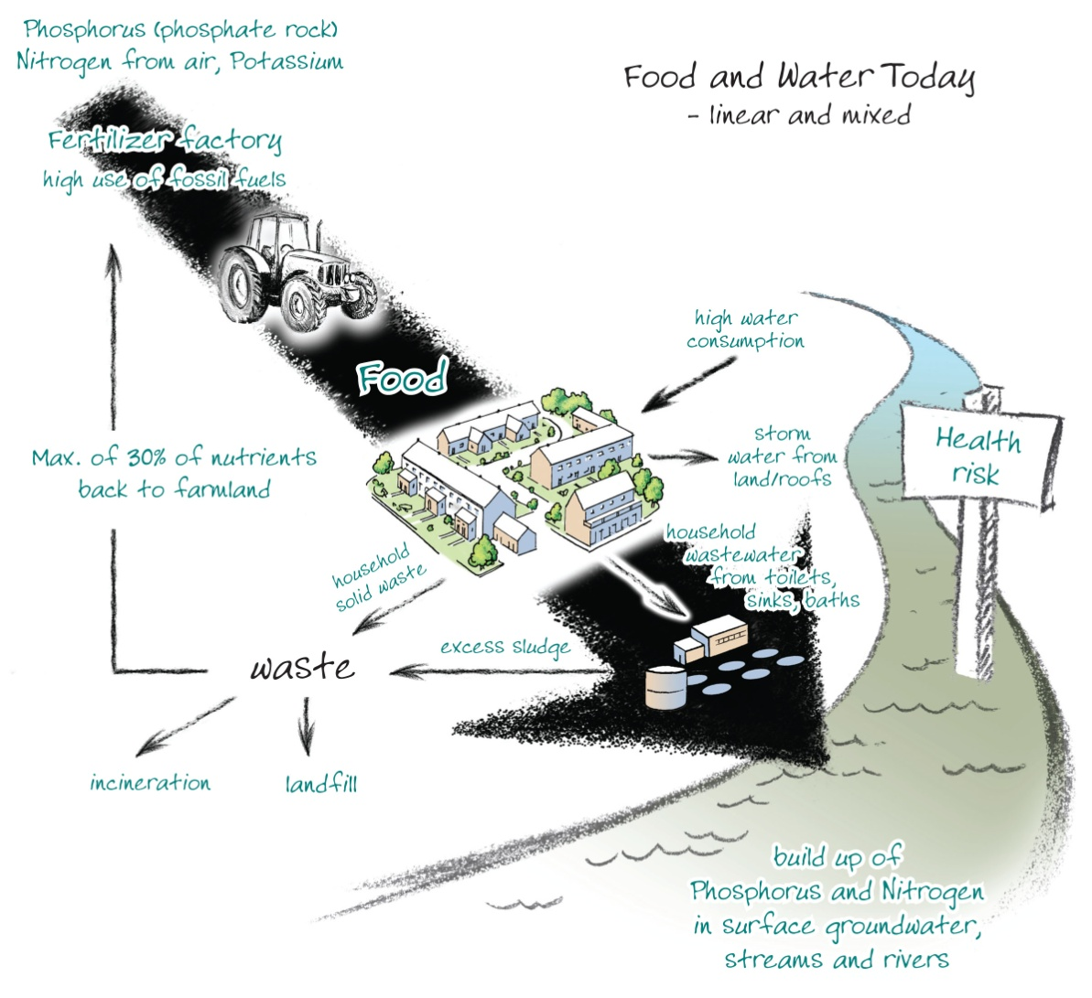
Fieldwork in Geography bilingual teaching
Torun 2nd – 4th October 2009
Food production

Slide 20
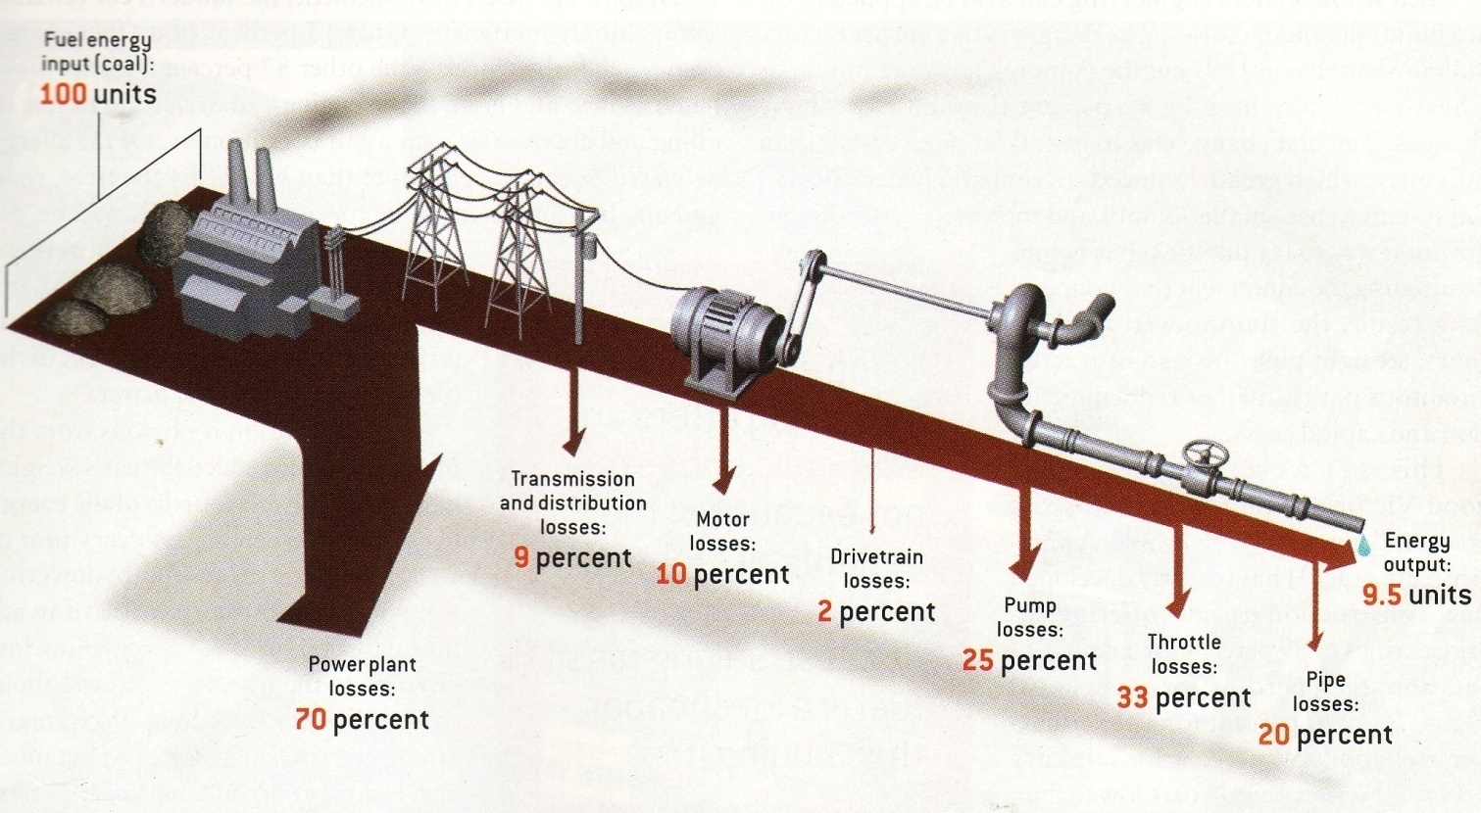
Fieldwork in Geography bilingual teaching
Torun 2nd – 4th October 2009
Energy

Slide 21
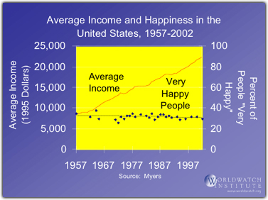
Fieldwork in Geography bilingual teaching
Torun 2nd – 4th October 2009
And doesn’t produce happiness

Slide 22

Fieldwork in Geography bilingual teaching
Torun 2nd – 4th October 2009

Slide 23
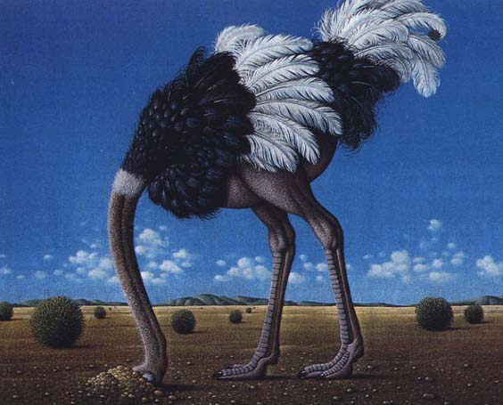
Fieldwork in Geography bilingual teaching
Torun 2nd – 4th October 2009

Slide 24
Fieldwork in Geography bilingual teaching
Torun 2nd – 4th October 2009
So …
We need something different?

Slide 25
Fieldwork in Geography bilingual teaching
Torun 2nd – 4th October 2009

Slide 26
Fieldwork in Geography bilingual teaching
Torun 2nd – 4th October 2009

Slide 27
Fieldwork in Geography bilingual teaching
Torun 2nd – 4th October 2009

Slide 28
Fieldwork in Geography bilingual teaching
Torun 2nd – 4th October 2009

Slide 29
Fieldwork in Geography bilingual teaching
Torun 2nd – 4th October 2009

Slide 30
Fieldwork in Geography bilingual teaching
Torun 2nd – 4th October 2009

Slide 31
Fieldwork in Geography bilingual teaching
Torun 2nd – 4th October 2009

Slide 32
Fieldwork in Geography bilingual teaching
Torun 2nd – 4th October 2009

Slide 33
Fieldwork in Geography bilingual teaching
Torun 2nd – 4th October 2009

Slide 34
Fieldwork in Geography bilingual teaching
Torun 2nd – 4th October 2009

Slide 35
Fieldwork in Geography bilingual teaching
Torun 2nd – 4th October 2009

Slide 36
Fieldwork in Geography bilingual teaching
Torun 2nd – 4th October 2009

