Slide 1
Cooperation in CLIL
Keith Kelly
keithpkelly@yahoo.co.uk

Slide 2
agenda
Perspectives – points of contact
Subject content and language
Subject thinking in language classes
Co-prep and co-teaching
Observation and feedback
AOB

Slide 3
Collaboration examples
International schools (ELLs department)
  prep courses, removal, in-class support
    Tashkent International School
Cross-curriculum collaboration (co-write)
    IES Sanchez Lastra, Spain
Akademisches Gymnasium Innsbruck
  Social Sciences and English dept meetings (BICEPS - Bilingual English Class for Economics, Personal Skills and Subject-specific Language)

Slide 4
Creating a CLIL identity
What is / should be the role of the English teacher in CLIL in your school?

Slide 5
You can’t test what you haven’t taught
Parachute jump
So, who teaches it?

Slide 6
Subject content and language
Look in your textbooks (subject and language) and curriculum guidelines. Are there any overlapping areas (content, language, skills)?
First, an example…

Slide 7
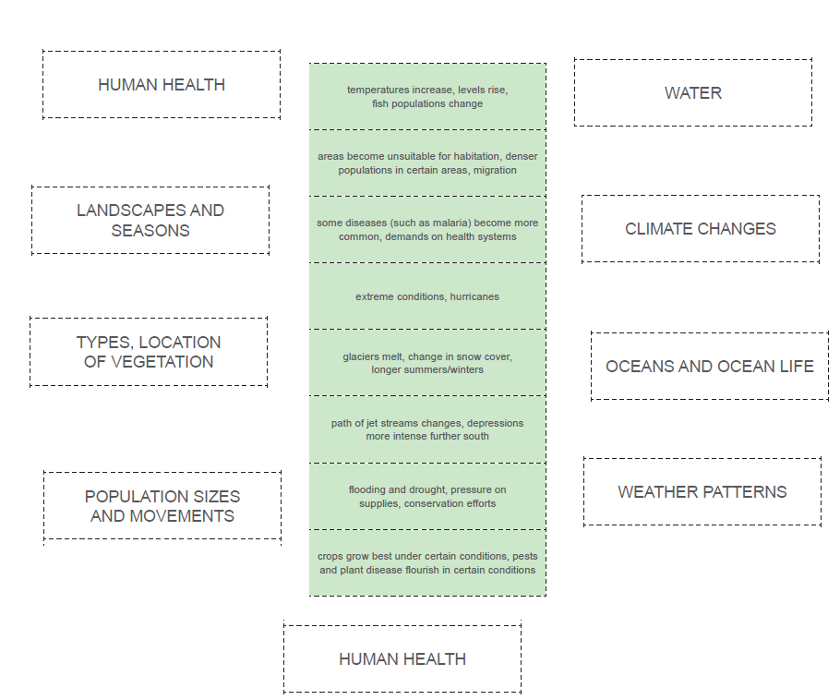
Key content, language and skills
Handout - Global warming
1 Match the categories with the consequences

Slide 8
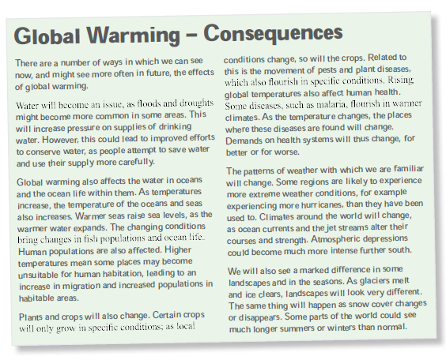
Key content, language and skills
2 Read handout and check

Slide 9
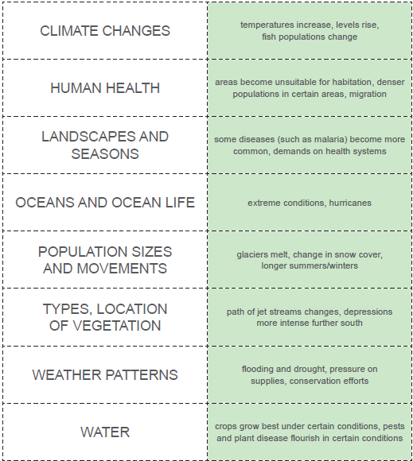
Factors and effects

Slide 10
Cause and effect
What language do your students need?
Handout - language of cause-effect.
What phrases would want your students to use?
In plenary
T - ‘Tell me about oceans and ocean life’
S – ‘Global warming will trigger… ‘

Slide 11
Where do we get this language from?
Textbooks
Teachers
The subject
The curriculum
Wherever you get it from, your students need it!
Look in your textbooks (subject and language) and curriculum guidelines. Identify content, language, skills.

Slide 12
In the English class
Plot where thinking skills (cause-effect, hypothesis) can be covered in the English class
Shapes in content (flow, tabular, tree)
Handout – Diet and disease
‘Coordinate the thinking in the curriculum and the language will come along by itself.’

Slide 13
Preparation and teaching
Co-preparing
Collaborate on visuals
Secondary economic activity (ppt, WS)
What should be prepared and by whom?
ELT - vocabulary

Slide 14
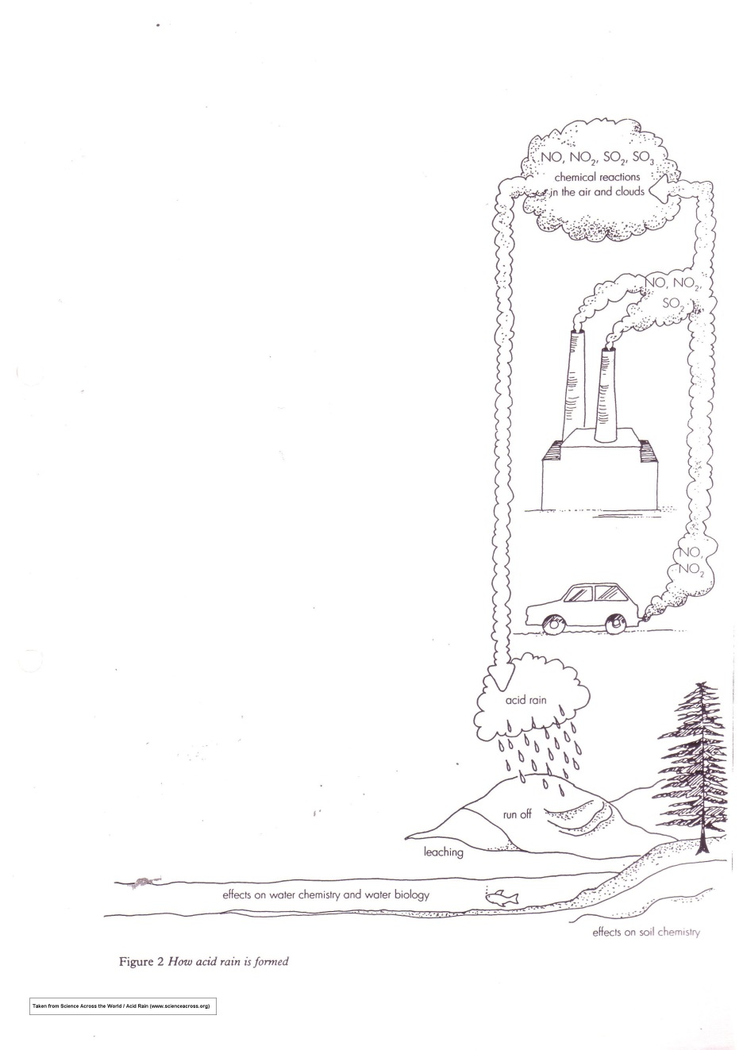
Co-teaching – possible?
Watching and listening
Handout – Acid Rain

Slide 15
Observation
Student production
S1 Gases are released from car exhausts and factories and they went up to the clouds there they react with uhm water in the clouds and fall down as acid rain and the acid rain runs off the hills, and leaching of the sea, or rivers and affects the chemistry of salts in the river.
S2 Uhm, the gases are released from cars or factories and arise into the sky. There, they are, they react with the water in the clouds and then they fall down, it falls down as acid rain. It runs off, it runs off the hillside and is leaching into the river and there it affects the water and soil chemistry.
analysis

Slide 16
Feedback
Identify an area you would like to investigate
Have it observed
Consider results
Instigate change
Irishman in Switzerland

Slide 17
AOB - Any other business
Roles and responsibilities
- Translation, checking language, timing, and time
- Networking (htl-clil@googlegroups.com, FACTWorld@yahoogroups.com)
- Share what you do

