Slide 1
A curriculum for an international education
Keith Kelly
keithpkelly@yahoo.co.uk

Slide 2
Agenda
What is an international education?
The EU context
The workplace (competing in employability)
Skills (Life Skills and EU Competences)
Languages (speaking several languages)
Classroom practice
Culture (becoming global citizens)
A model for communication through education
(Science Across the World)
International networking (schools links)

Slide 3
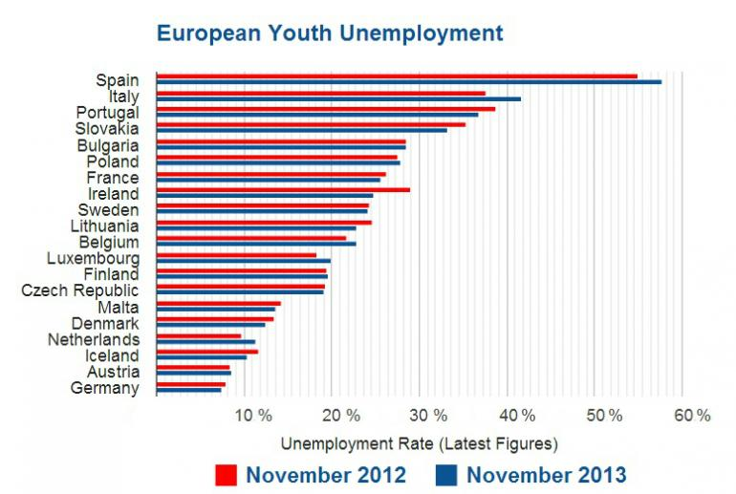
European context
Spain and Austria

Slide 4
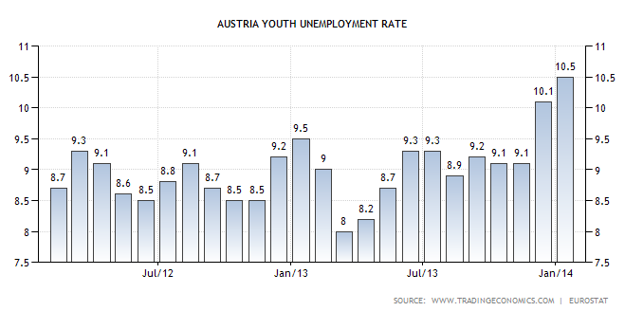
Austrian youth unemployment

Slide 5
European context
Young people, mobility and employability
What makes young people mobile?
Languages
What makes young people employable?
Soft skills as much as technical skills

Slide 6
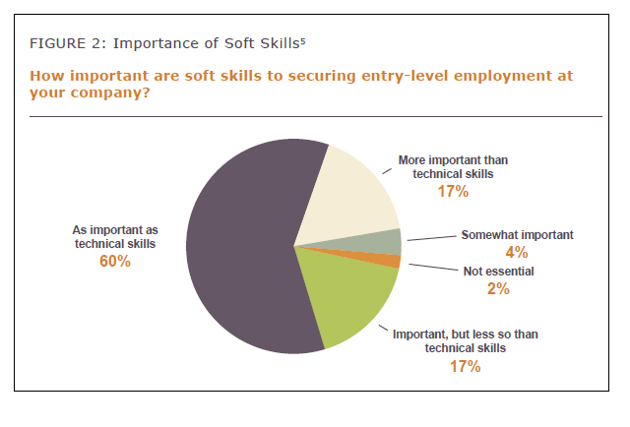
What employers say
The Importance of Soft Skills in Entry-Level Employment and Postsecondary Success: Perspectives from Employers and Community Colleges, Seattle Jobs Initiative 2013

Slide 7
What are life skills?
personal management and social skills which are necessary for adequate functioning on an independent basis
International Bureau of Education
Life skills education is designed to facilitate the practice and reinforcement of psychosocial skills in a culturally and developmentally appropriate way; it contributes to the promotion of personal and social development
World Health Organisation
It is evident that in addition to practical and vocational skills, other types of skills such as social, individual and reflective skills are also needed. Life skills programmes emphasise abilities that help to facilitate communication, negotiation, to think critically and solve problems and make independent decisions.
UNESCO Institute for Education

Slide 8
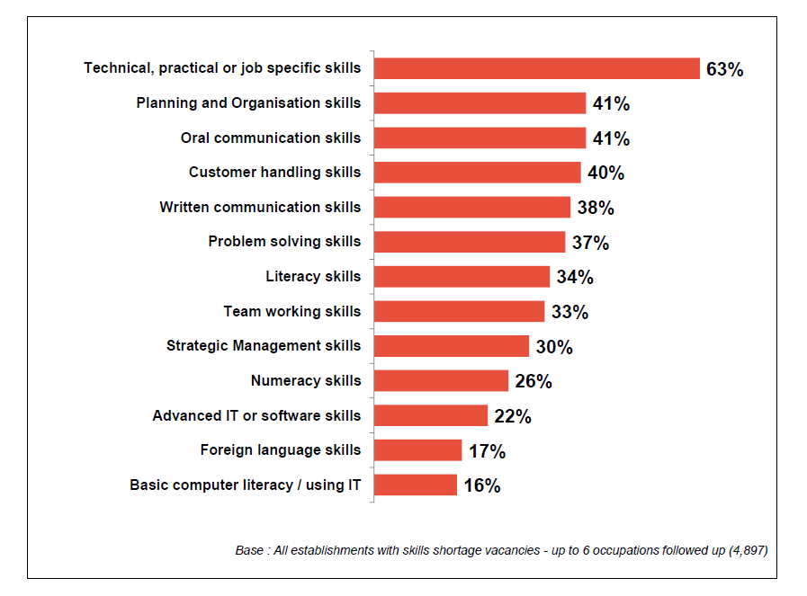
Skills lacking
UK Commission for Employment and Skills Report, 2014

Slide 9
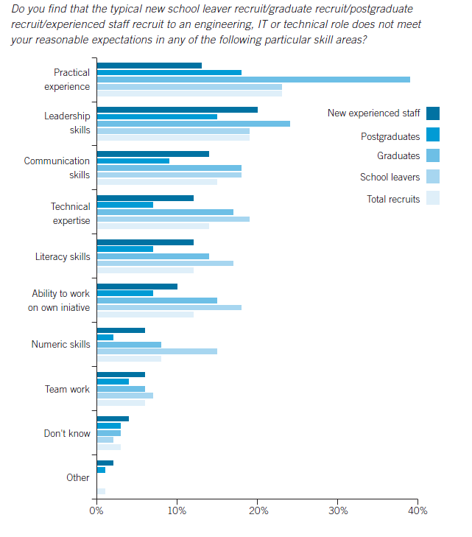
Skills lacking
Institute of Engineering and Technology Annual Survey 2013

Slide 10
Top ten skills that employers want
1 Verbal communication
2 Teamwork
3 Commercial awareness
4 Analysing and investigating
5 Initiative / Self-motivation
6 Drive
7 Written communication
8 Planning & organising
9 Flexibility
10 Time management
University of Kent study of multiple surveys

Slide 11
Other skills seen as important
global skills
negotiating & persuading
leadership
numeracy
computing skills
self-awareness
confidence
lifelong learning
stress tolerance
integrity
independence
developing professionalism
action planning
decision-making
interpersonal sensitivity
creativity
University of Kent study of multiple surveys

Slide 12
A model for intercultural communicative education
Culture A and Culture B
AA | BA
AB | BB
Know how your own culture sees itself
Know how other culture sees your culture
Know how your culture sees other culture
Know how other culture sees itself

Slide 14
Science Across the World
Exchange programme between schools world wide (141 countries), based on two foundations: existing resources for students (age 10-18) and a database with >7140 participating schools

Slide 15
Aims of the programme
Science / ’all’ subjects (cross curricular): investigations in the neighbourhood, human activities
International collaboration: exchange data with students in schools abroad
Language: developing language and communication skills
ICT: meaningful use

Slide 16
Topics (1)
Acid rain (12/16)
Biodiversity around us (12/15)
Chemistry in our lives (12/15)
Climate change (14-16)
Domestic waste (12/16)
Drinking water (12/15)
Eating and drinking (10/12)
Global warming (15/16)
Keeping healthy (12/15)
Plants and me (10-12)
Renewable energy (12/15)
Talking about Genetics (14/16)
What do you eat? (12-14)

Slide 17
Topics (2)
English and many other languages (e.g. Portuguese, Italian, French, German, Spanish, Chinese, Japanese, Russian, Arabic)
topics web based or downloadable

Slide 18
Structure
Teachers’ notes (language and science)
Exchange form: heart of the topic
Students’ pages
activities
discussion
Ideas for extra activities

Slide 19
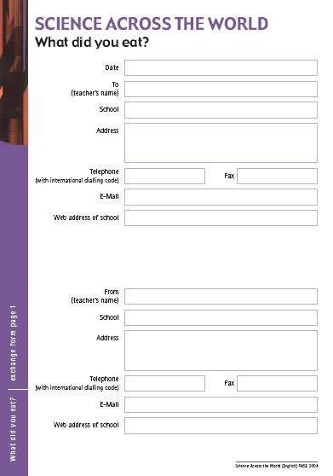
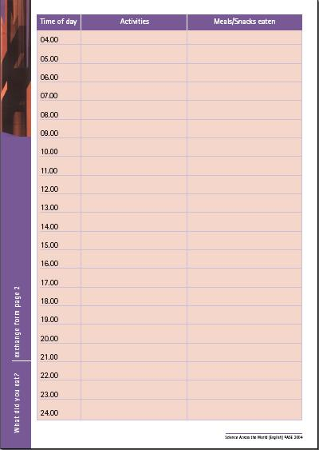
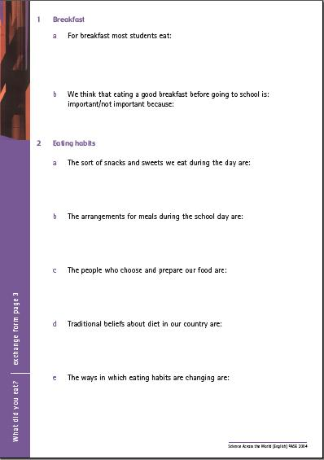
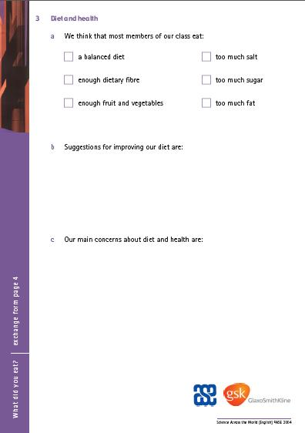
The Exchange Form

Slide 20
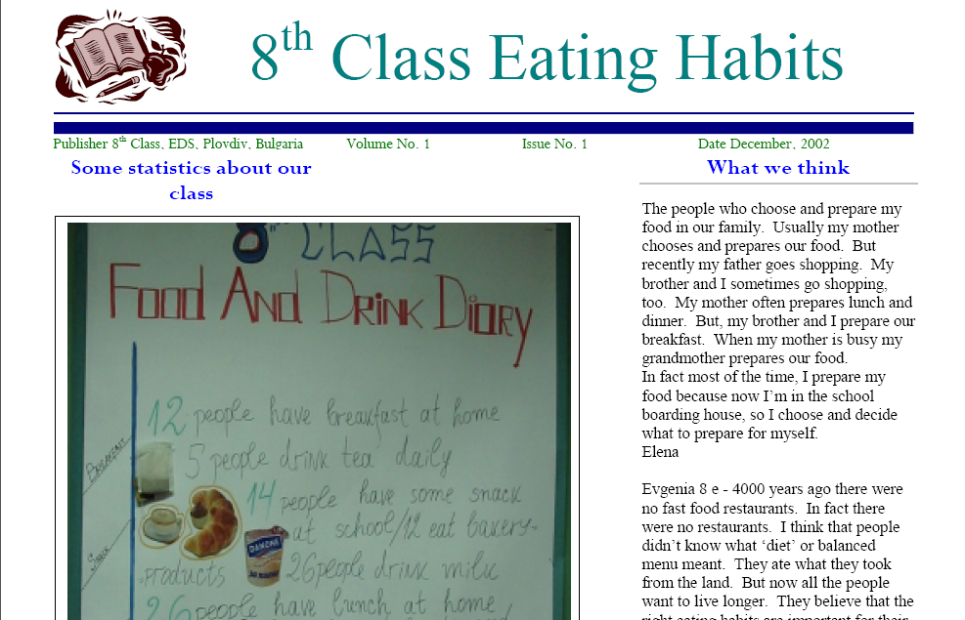
Sample Exchange Form - Bulgaria

Slide 21
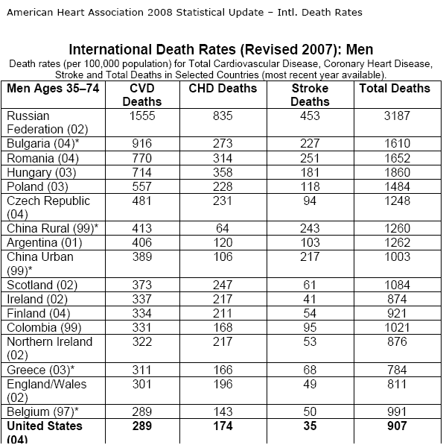
Researching Country Data - Bulgaria

Slide 22
http://mtn2.e2bn.org/mtn/

Slide 23
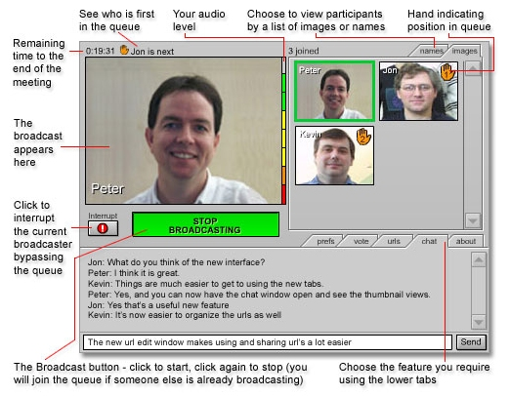
http://flashmeeting.e2bn.net/index.html

Slide 24
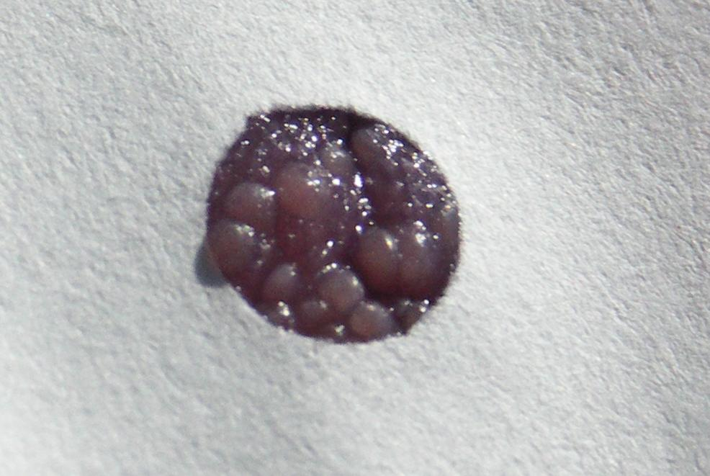
Heredity – surveying variation

Slide 25
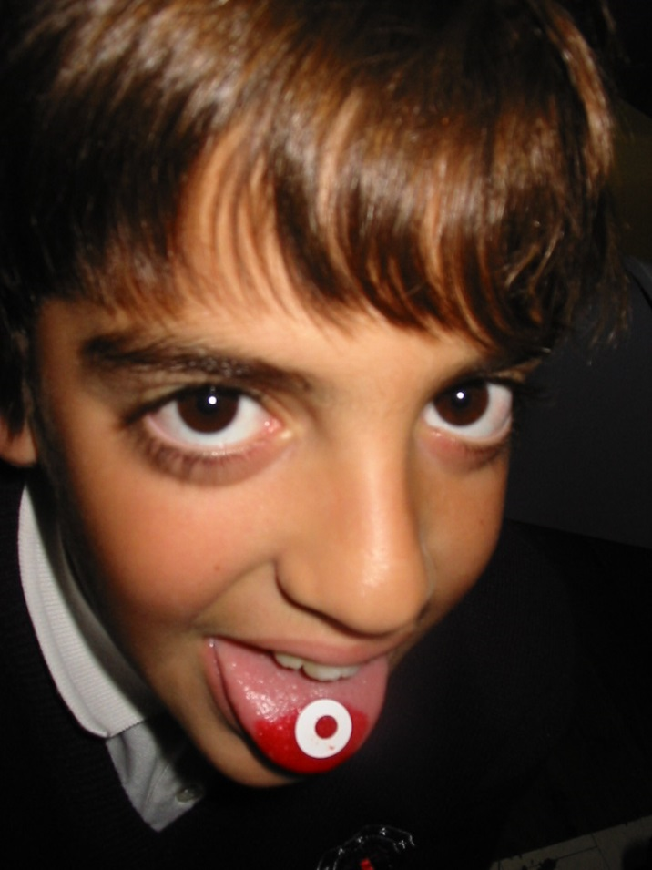
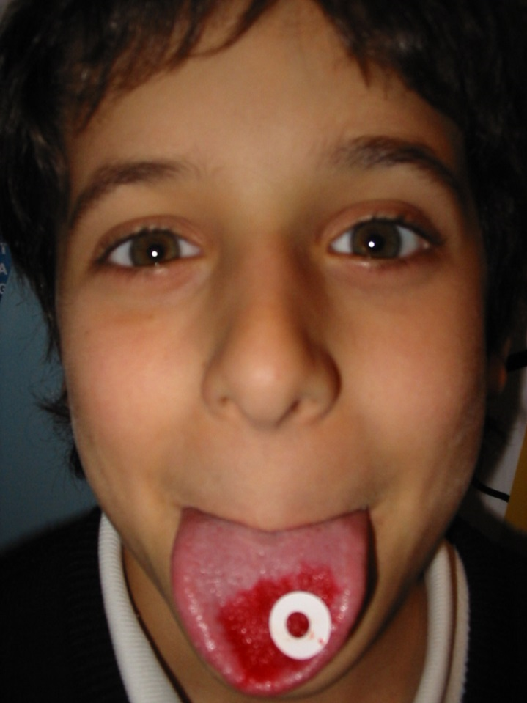
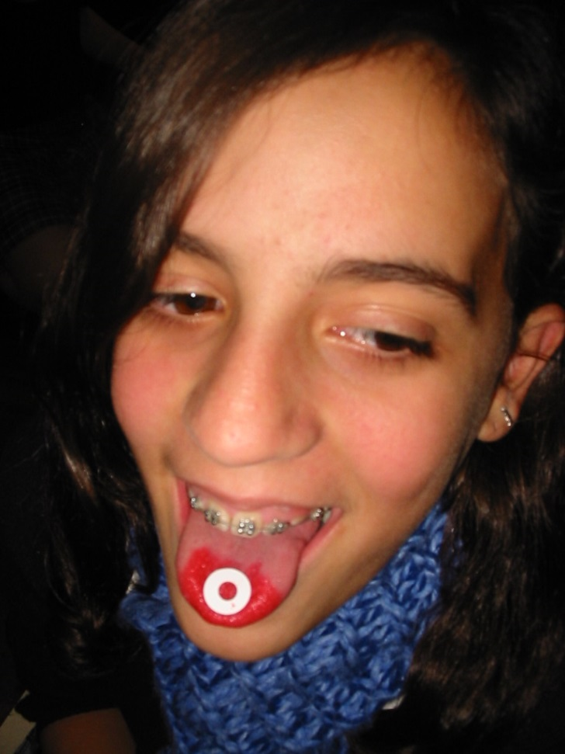
Taste buds

Slide 26
What can we survey in a group?
taste buds
height
hair colour (real hair colour)
eye colour
skin colour
middle finger hair
earlobes: attached / not attached
tongue rolling
others:
shape of nose, shape of face, shoe size

Slide 27
Practical work (1)
Chemistry in Our Lives topic, students prepare their own chemical product and share their methodology with others.
Bright pink nail polish made from gumamela flowers in the Philippines and laundry soap from vegetable oil and banana stalks in Singapore.

Slide 28
Practical work (2)

Slide 29
Young Ambassadors for Chemistry
Collaboration between
Science Across the World
IUPAC
Projects in
Taiwan, Argentina, Siberia, Korea, South Africa, Egypt, Jordan, Gulf Region, Estonia, Lithuania, Bulgaria, Mauritius, Cyprus, Philippines

Slide 30
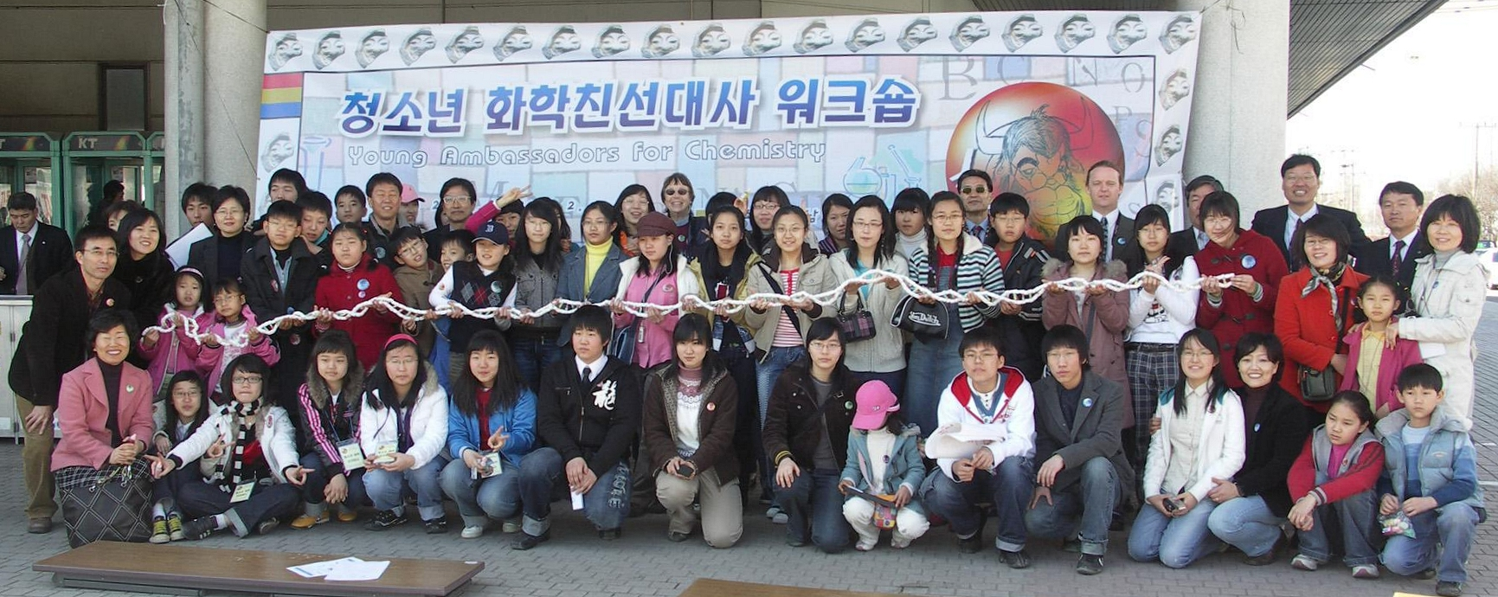
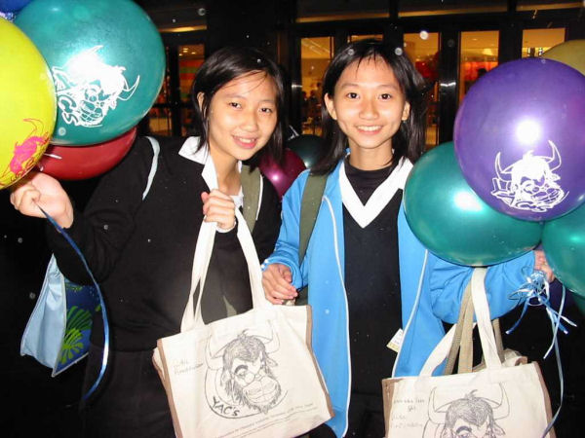
Korea
Taiwan

Slide 31
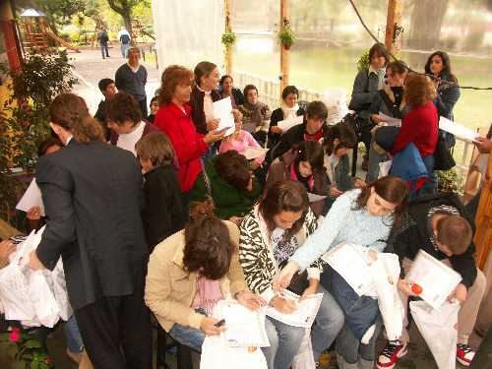
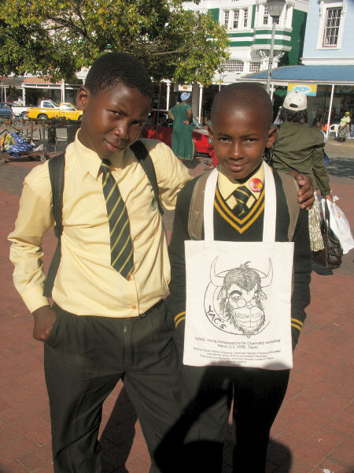
Argentina
South Africa

Slide 32
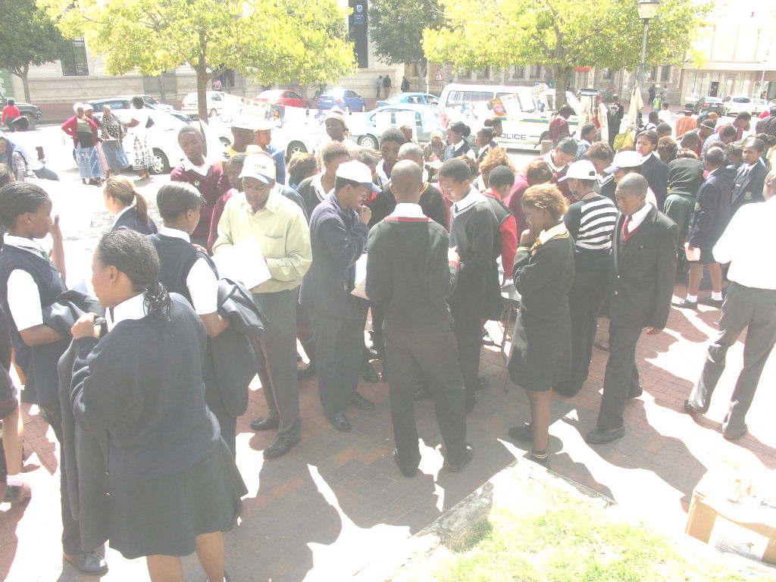
Grahamstown, South Africa, 2007 Young Ambassadors for Chemistry

Slide 33
Acid Rain – Sao Paolo

Slide 34
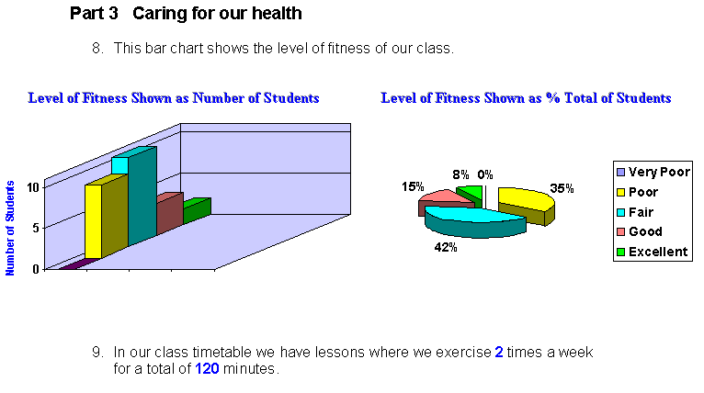
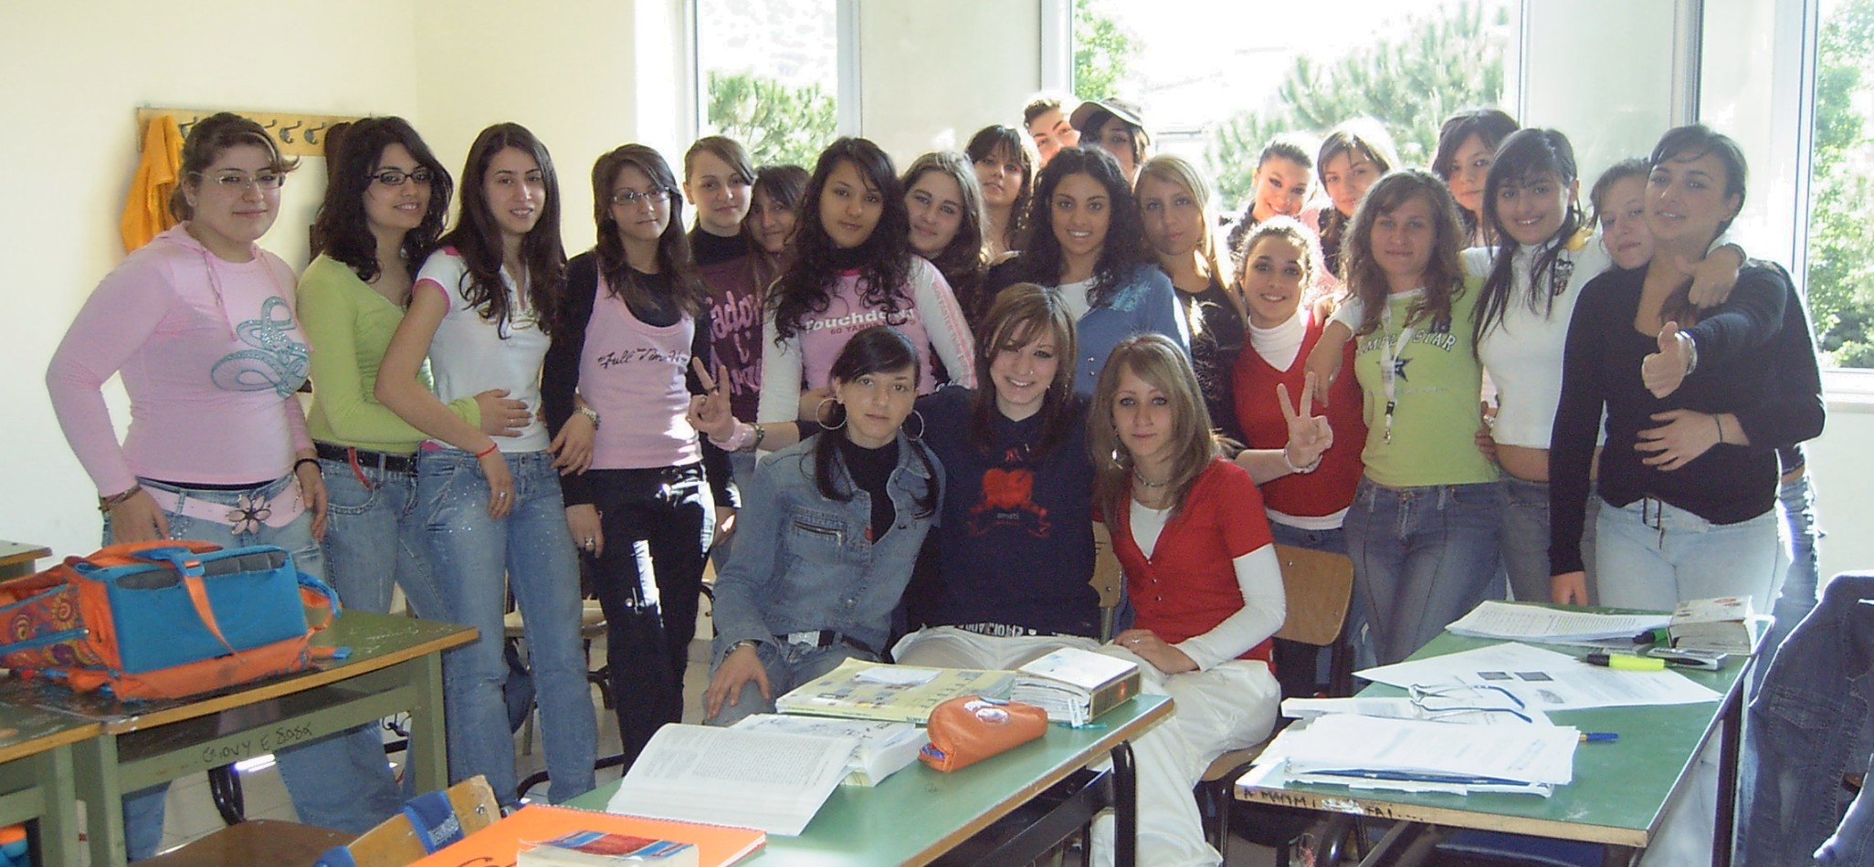
Scuola Magistrale Don Carlo Gnocchi, Italy

Slide 35
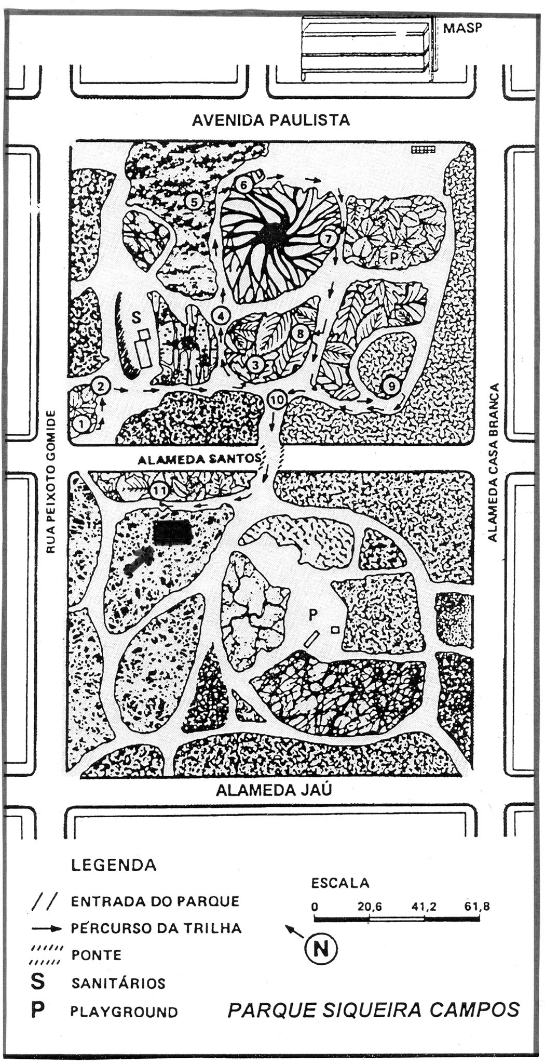
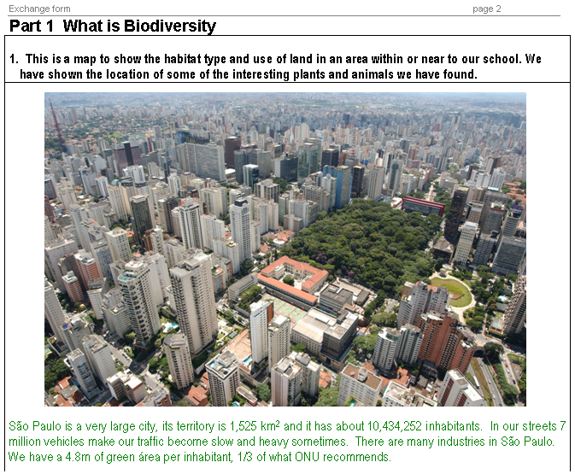
Biodiversity – map your area
1
2
3
4
5
Área escolhida
para coleta de material
Nossa escola

Slide 36
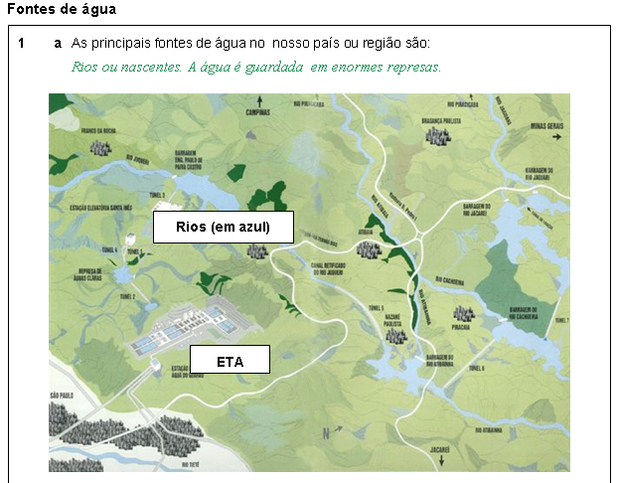
Drinking Water

Slide 37
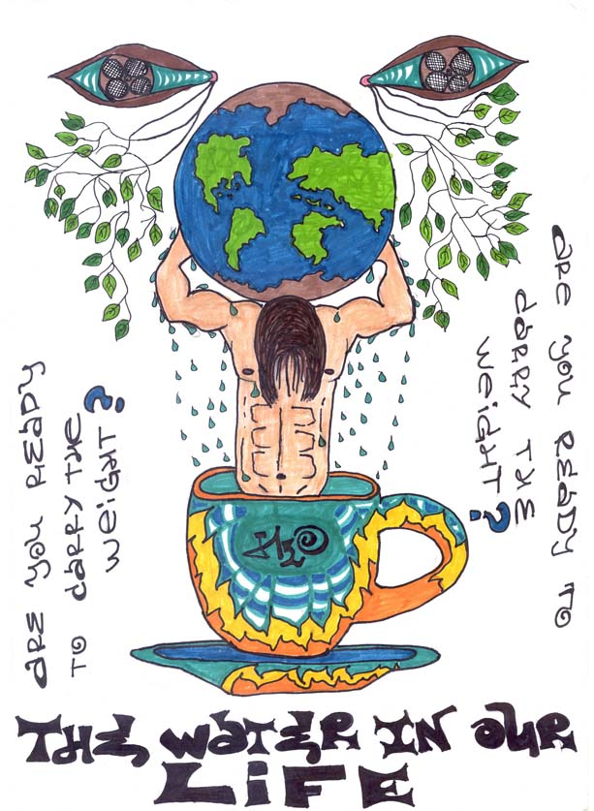
Artwork

Slide 38
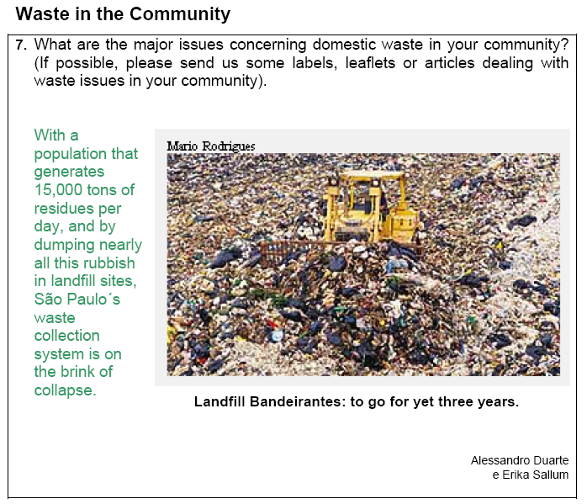
Domestic Waste – Real Issues

Slide 39
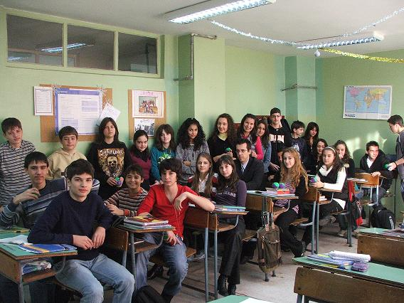
Road Safety – Bulgaria

Slide 40
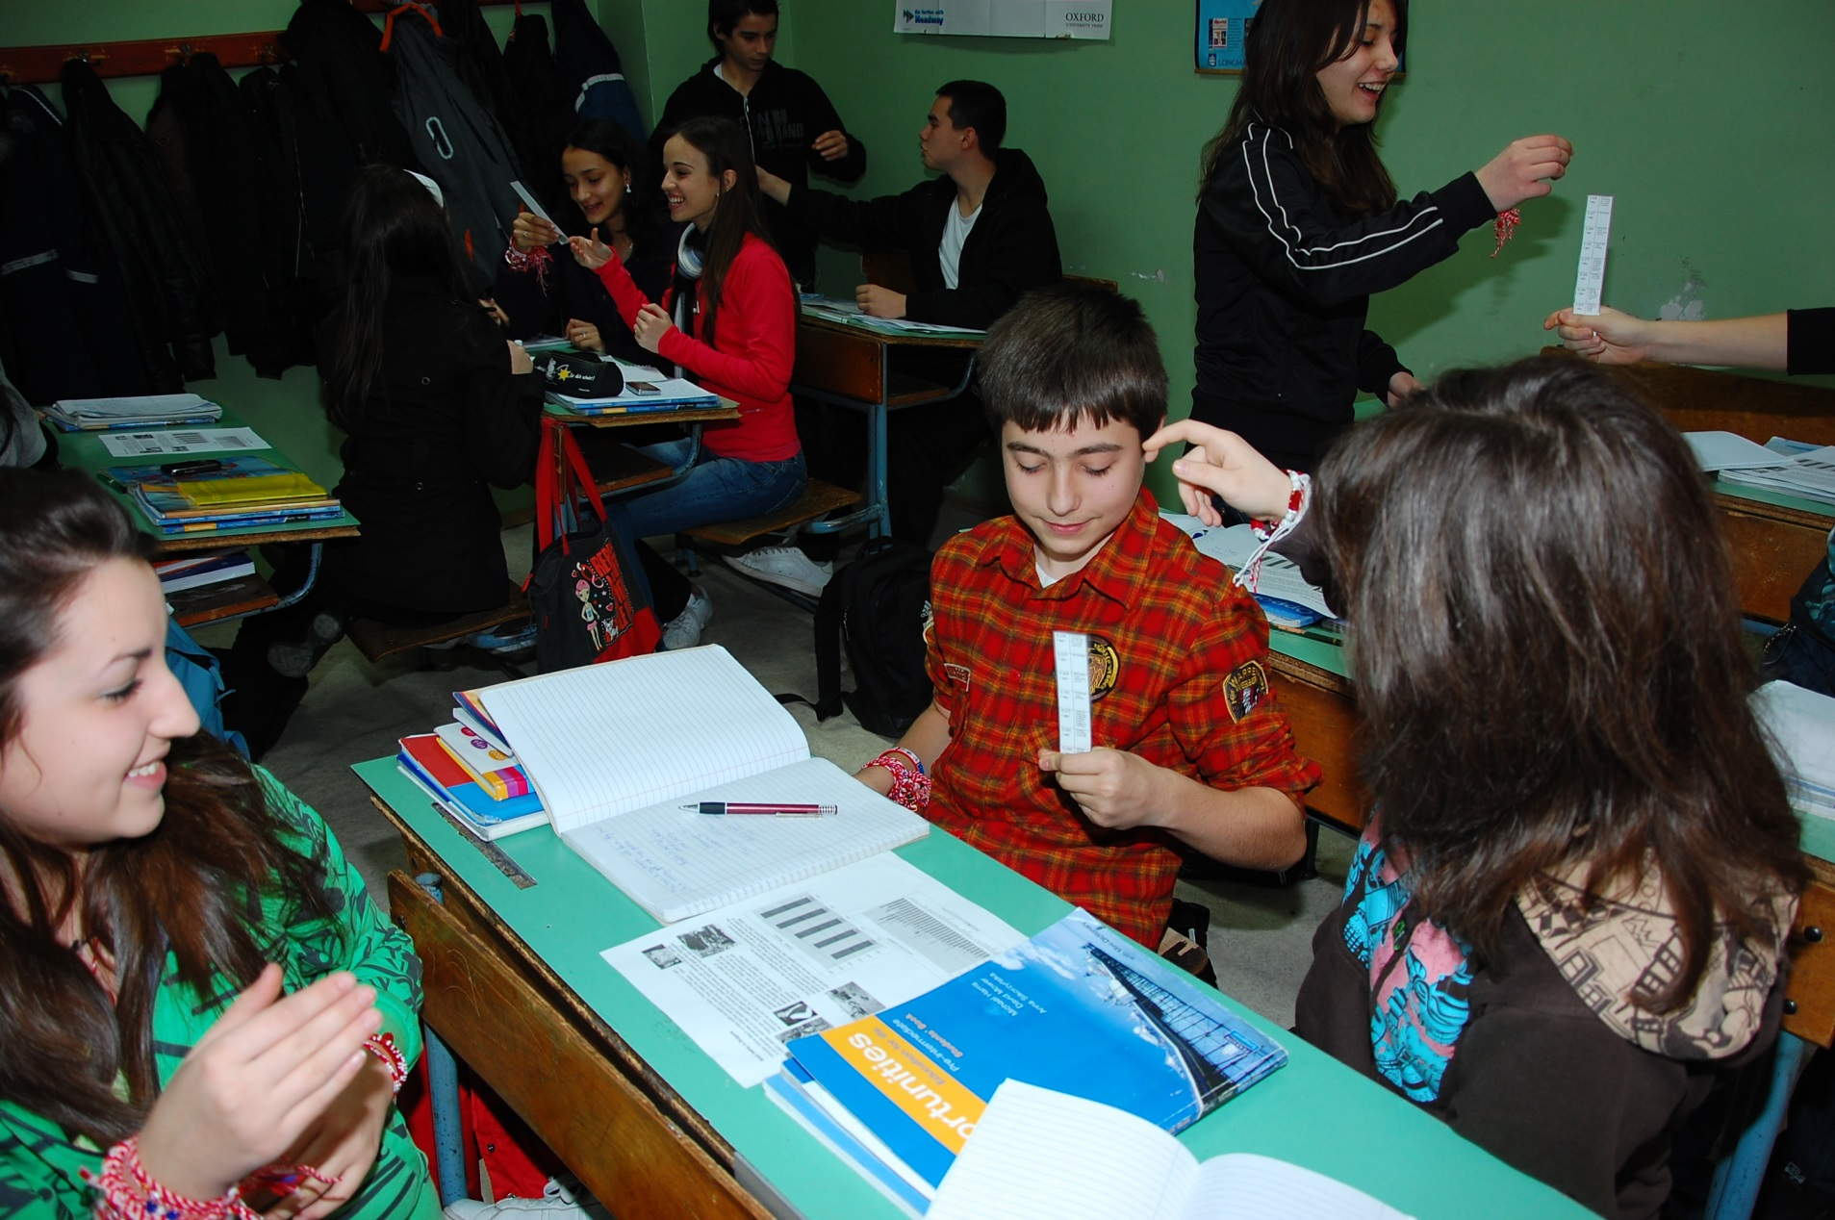
Speed reaction

Slide 41
Agenda
What is an international education?
The EU context
The workplace (competing in employability)
Skills (Life Skills and EU Competences)
Languages (speaking several languages)
Classroom practice
Culture (becoming global citizens)
A model for communication through education
(Science Across the World)
International networking (schools links)

Slide 42
Links
factworld@yahoogroups.com
e-group with 3500 teachers around the world
www.factworld.info (undergoing update)
(forum for across the curriculum teaching)
www.scienceacross.org
Science Across the World

